Slide 1

A Level Computer Science
Topic 5: Computer Architecture and Assembly
Teaching London Computing
William Marsh
School of Electronic Engineering and Computer Science
Queen Mary University of London

Slide 2
Aims
Understand CPU structure in more detail
  Fetch-execute cycle
  Faster CPUs
Write simple assembly code
  Use Little Man Computer
Understand principles of compiling
Compare compilers and interpreters

Slide 3
CPU Structure
What’s in a CPU

Slide 4
Simple Computer
Processor
  CPU
Memory
  Data
  Program instructions
I/O
  Keyboard
  Display
  Disk
Memory
addresses
data
CPU
data
Keyboard
I/F
Disk
I/F
Display
I/F

Slide 5
Memory
data
Each location
  has an address
  hold a value
Two interfaces
  address – which location?
  data – what value?
address

Slide 6
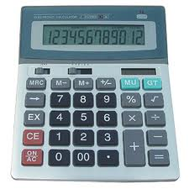
Registers (or Accumulators)
A storage area inside the CPU
VERY FAST
Used for arguments and results to one calculation step
data
Register – 1 memory location
Read register
Write to register
Control lines

Slide 7
CPU Structure
ALU
Accumulators
  Data for calculation
Data
  Word to/from memory
PC
  Address of next instruction
Instruction
Address
  For memory access
Accumulators
ALU
data
Data
Control Unit
Program
Counter
Instruction
memory
address
Address
Control
Unit

Slide 8
Instructions
OpCode
Address
Instruction
  What to do: Opcode
  Where: memory address
Instructions for arithmetic
  Add, Multiply, Subtract
Memory instructions
  LOAD value from memory
  STORE value in memory

Slide 9
Add Instruction
Add
Address
One address and accumulator (ACC)
  Value at address added to accumulator
ACC = ACC + Memory[Address]

Slide 10
Little Man Computer
A Simulator for a Simple CPU

Slide 11
Advantages of LMC
Very simple
Number of implementations
  Java applet
  Excel
  Flash, .net
  MacOS
Some incompatibilities
Feature: uses decimal not binary

Slide 12
LMC CPU Structure
Visible registers shown in red
ALU
Accumulator
ALU
data
MEM Data
Control Unit
Program
Counter
Instruction
memory
address
Mem
Address
Control
Unit

Slide 13
Memory locations
Accumulator
Program counter

Slide 14
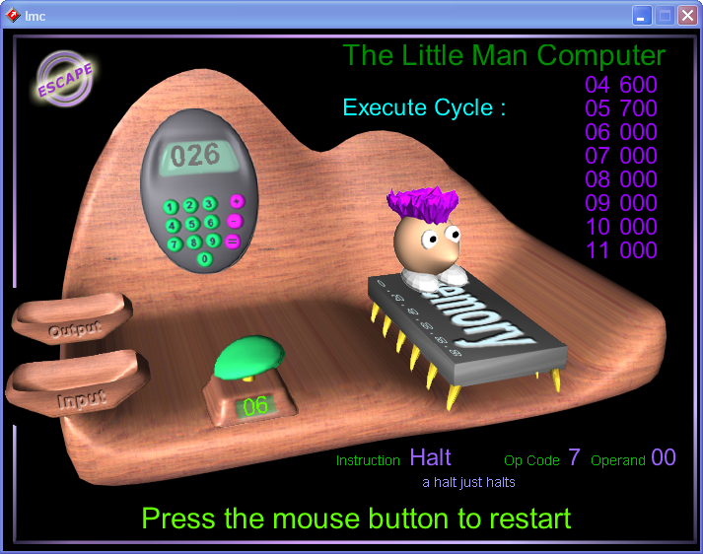
Windows .net LMC
Excel LMC
Flash LMC

Slide 15
Feature Comparison
Step and Animation
  Most allow single stepping – see fetch-execute
  Animation – e.g. flash version
Can program using mnemonics
  LDA, STA, ADD …
  Supported in e.g. applet
  Not supported in Excel, Flash versions
Programming versus demonstration

Slide 16
LMC Instructions

Slide 17
Instructions
OpCode
Address
Opcode: 1 decimal digit
Address: two decimal digits – xx
Code | Mnemonic | Description
000 | HLT | Halt
1xx | ADD | Add: acc + memory → acc
2xx | SUB | Subtract: acc – memory → acc
3xx | STA | Store: acc → memory
5xx | LDA | Load: memory → acc
6xx | BR | Branch always
7xx | BRZ | Branch is acc zero
8xx | BRP | Branch if acc > 0
901 | IN | Input
902 | OUT | Output

Slide 18
Add and Subtract Instruction
ADD
Address
SUB
Address
One address and accumulator (ACC)
  Value at address combined with accumulator value
  Accumulator changed
Add: ACC ← ACC + Memory[Address]
Subtract: ACC ← ACC – Memory[Address]

Slide 19
Load and Store Instruction
LDA
Address
STA
Address
Move data between memory and accumulator (ACC)
Load: ACC ← Memory[Address]
Store: Memory[Address] ← ACC

Slide 20
Branch Instructions
BR
Address
Changes program counter
May depend on accumulator (ACC) value
BR: PC ← Address
BRZ: if ACC == 0 then PC ← Address
BRP: if ACC > 0 then PC ← Address

Slide 21
Practical Exercises 1.1
Enter the program for example 1.1
Understand how to
  Enter
  Assemble / compile
  Run the program
See notes on available versions.

Slide 22
LMC Example

Slide 23
Compiling a Simple Program
Compiler translates high level program to low level
E.g. x = y + z
LDA y
ADD z
STA x
HLT
x
y
z

Slide 24
Running the Simple Program
PC
LDA y
ADD z
IR
LDA
STA x
HLT
ACC
17
x
y 17
z 9

Slide 25
Running the Simple Program
PC
LDA y
ADD z
IR
ADD
STA x
HLT
ACC
17
26
x
y 17
z 9

Slide 26
Running the Simple Program
PC
LDA y
ADD z
IR
STA
STA x
HLT
ACC
26
x
26
y 17
z 9

Slide 27
Running the Simple Program
PC
LDA y
ADD z
IR
HLT
STA x
HLT
ACC
26
x
26
y 17
z 9

Slide 28
Practical Exercises 1.3-1.7
Try any of the challenge problems 1.3 to 1.7
1.4 onwards require the use of branch instructions
  If statements
  Loops
See notes for examples

Slide 29
Fetch-Execute Cycle
How the Computer Processes Instructions

Slide 30
Fetch-Execute
Each instruction cycle consists on two subcycles
Fetch cycle
  Load the next instruction (Opcode + address)
  Use Program Counter
Execute cycle
  Control unit interprets the opcode
  ... an operation to be executed on the data by the ALU
Fetch next instruction
Decode & execute instruction
Start
Halt

Slide 31
Fetch Instruction
ALU
Program counter to address register
Read memory at address
Memory data to ‘Data’
‘Data’ to instruction register
Advance program counter
Accumulators
ALU
data
3
Data
Control Unit
4
Program
Counter
Instruction
memory
1
address
Address
Control
Unit
2

Slide 32
Execute Instruction
Decode instruction
Address from instruction to ‘address register’
Access memory
Data from memory to ‘data register’
Add (e.g.) data and accumulator value
Update accumulator
ALU
Accumulators
6
5
ALU
5
data
4
Data
Control Unit
2
Program
Counter
Instruction
memory
1
address
Address
Control
Unit
3

Slide 33
Address of memory access
Data to/from memory

Slide 34
Summary of CPU Architecture
Memory contains data and program
  Program counter: address of next instruction
  Instructions represented in binary
  Each instruction has an ‘opcode’
Instructions contain addresses
  Addresses used to access data
Computer does ‘fetch-execute’
  ‘Execute’ depends on opcode
Computer can be built from < 10,000 electronic switches (transistors)

Slide 35
Discussion
Could we act out the way a computer works?
Can you explain he key idea of the stored program computer simply?
Should we be amazed at the working of a computer?

Slide 36
Practical Exercise 1.2
Review the fetch execute steps using LMC

Slide 37
Compilers and Interpreters

Slide 38
Compiler
Compiler translates high level program to low level
Compiled languages
  Statically typed
  Close to machine
  Examples: C, C++, (Java)
  Compiler for each CPU
assembly code
source code
LDA y
ADD z
STA x
HLT
11010101
10010111
01110100
10000000
x = y + z
object code

Slide 39
Inside a Compiler
CPU
object code
source code
Abstract syntax tree
11010101
10010111
01110100
10000000
code
generator
x = y + z
parser
type checker
Parser: checks that the source code matches the grammar
Type checker: checks types of variables and expressions
Code generator: generates (optimised) code

Slide 40
Principle of an Interpreter
CPU-L
CPU-X
11010101
10010111
01110100
x = y + z
Rep of C
Code (C) in language L
Interpreter in X for L
One machine can emulate another
  ‘micro-coded’ CPU
  Intel CPUs and RISC inside

Slide 41
Java and .NET Language
Java is compiled to ‘byte code’
Byte code for Java ‘virtual machine’ (JVM)
  One compiler
  Libraries
  Other languages
JVM
CPU
Java code
11010101
10010111
01110100
Java compiler
x = y + z
byte code
Byte code interpreter
The JVM is emulated on real computers
  ‘JIT’ compiler

Slide 42
How Does an Interpreter Work?
State of the LMC: registers and memory
Example: LMC emulator
acc = 0
mdr = 0
mar = 0
pc = 0
memory = [504,105,306, 0,
11, 17,...]
def readMem(memory):
global mdr
mdr = memory[mar]
def execute(memory, opcode, arg):
global acc, mar, mdr, pc
if opcode == ADD:
mar = arg
readMem(memory)
acc = acc + mdr
elif opcode == SUB:
mar = arg
readMem(memory)
acc = acc – mdr
...
def fetch(memory):
global pc, mar
mar = pc
pc = pc + 1
readMem(memory)
Update state following rules

Slide 43
Practical Exercise 1.2
What would the benefits be for your pupils in completing an exercise such as this?

Slide 44
Making a Faster Computer

Slide 45
Clock
Steps in sequence are controlled by a clock
Clock frequency
  8086 – 10 MHz
  Pentium 4 – 3 GHz
  However, clock speeds no longer increasing much
Processing power depends on
  Clock speed
  Clock cycles to execute an instruction

Slide 46
1GHz Clock
10⁹ cycles per second
  1 cycle every 1 ns
  Light travels 1 m in approx 3 ns
  Billion instructions per second (up to)
Each instruction takes longer
  … many instruction in process at once
Memory access is slower
  10 of ns

Slide 47
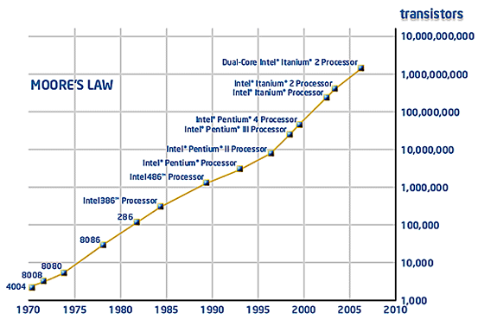
Moore’s Law
Notes:
http://www.intel.com/technology/mooreslaw/index.htm

Slide 48
Faster Computer
Faster clocks
  smaller IC lines (90 → 45 → 32 → 22nm)
  shorter time to switch
More Registers; Bigger registers
  32 → 64 bits
Fetch-execute pipeline
  overlap the fetch and execute
Cache memory
Multiple cores

Slide 49
Intel 86 Family
8086 – 1978
  16 bits
80386 – 1986
  32 bits
Pentium 4 – 2000
  32 bits → 64 bits
Intel core i3, i5, i7
COMPATIBLE compiled program
More instruction
Longer words
More on chip
  floating point
  cache memory
Instructions in parallel
  pipeline
  superscalar
  multi-core

Slide 50
Summary
A CPU executes Fetch-Execute
  Fetch: next instructions from memory
  Execute: data to/from memory and accumulator
  Opcode determines execute
One machine can emulator another
Program execution
  Compiler: translates
  Interpreter: parses then interprets
  Blend: Java or .NET and byte code

