Slide 1


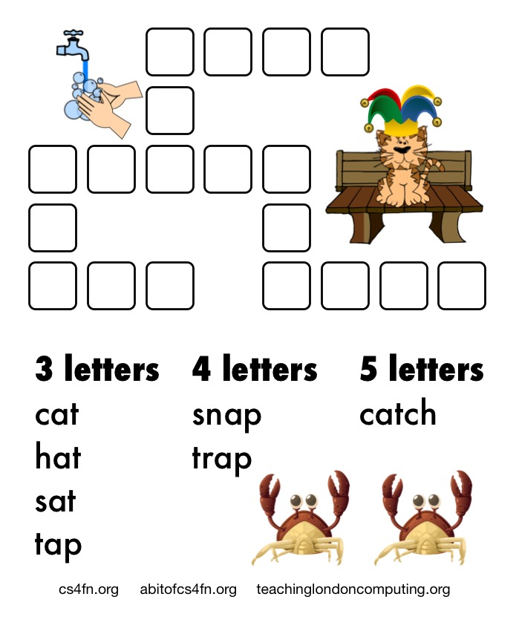
How to solve a
Kriss-Kross:
an introduction to logical thinking
Paul Curzon
Queen Mary University of London

Slide 2
Solving Problems through Logical Thinking
Logical thinking is just about thinking clearly and being careful.
Look for clues that are useful now.
Some clues won’t be useful yet. Just be patient! You just need other clues first.
Check and double check.

Slide 3
Solving Kriss-Kross
A good clue to look for first …
Find a word length that has only one word of that length

Slide 4
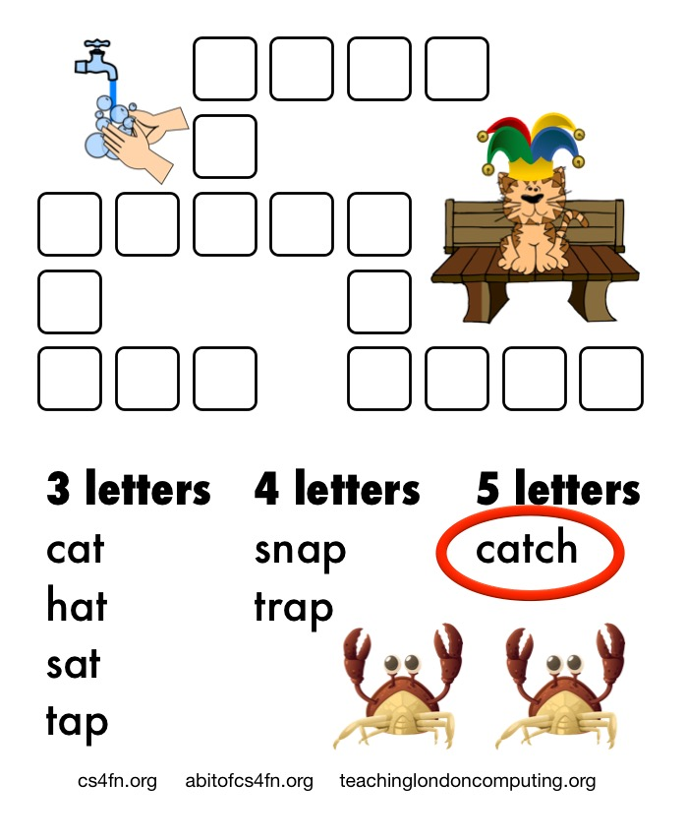
Find a word length that has only one word of that length

Slide 5
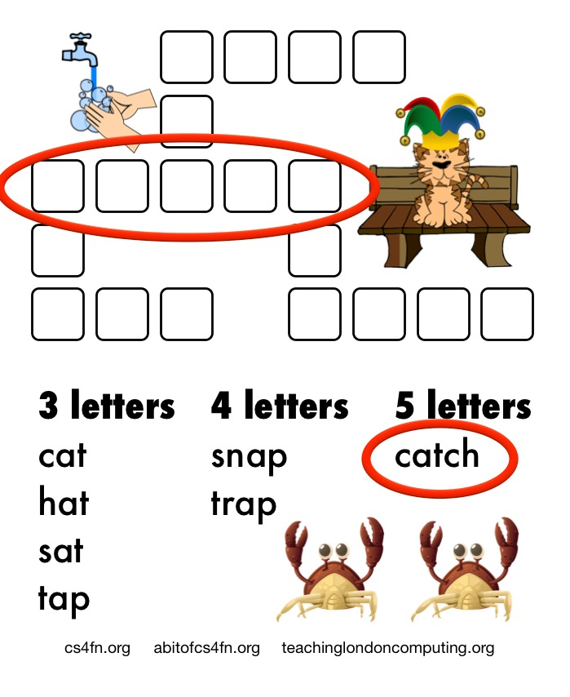
Then find a word in the grid of that length

Slide 6

and fill in the word

Slide 7
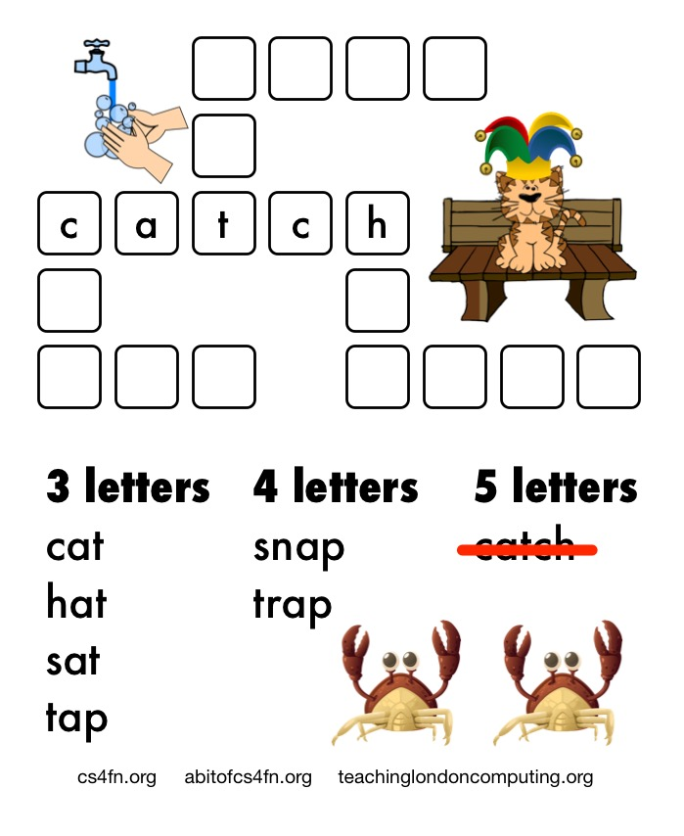
then cross the word off …
so you know which you have used!

Slide 8
Now look for more clues.
Which words in the grid have letters that mean only one word fits?

Slide 9
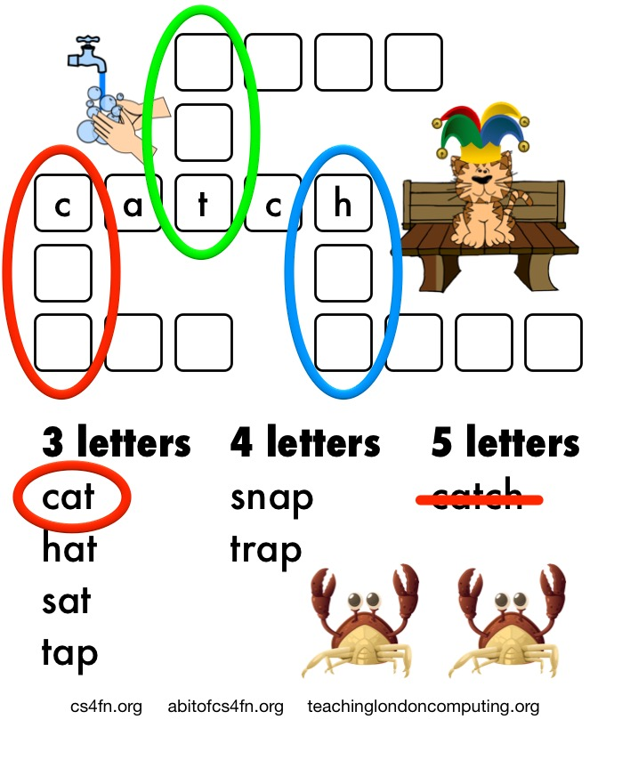
Lots end in t so that is no help
but only one 3-letter word starts with c
(only one starts with h so that’s possible too)

Slide 10
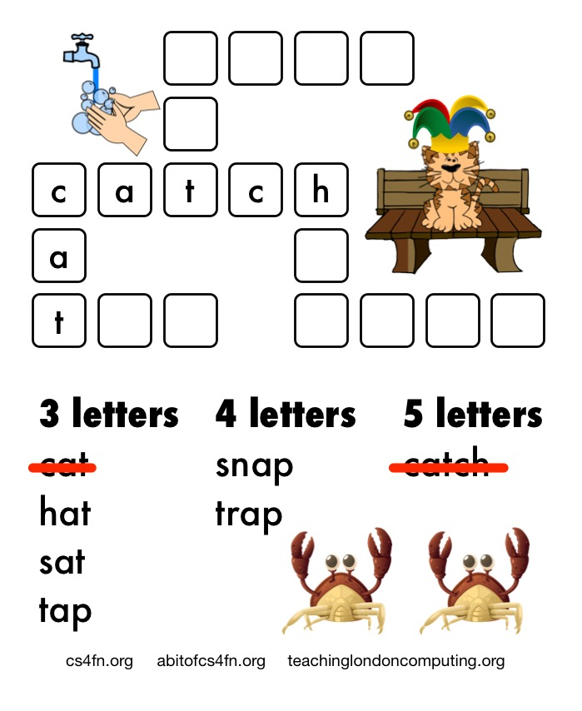
Fill in that word (cat)
Then cross it off.

Slide 11
Now what other clues mean only one word fits?

Slide 12
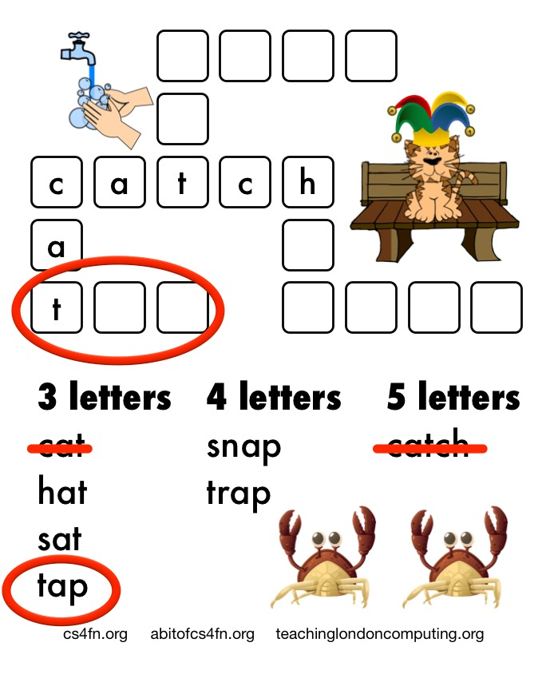
Only one three letter word starts with t - tap

Slide 13
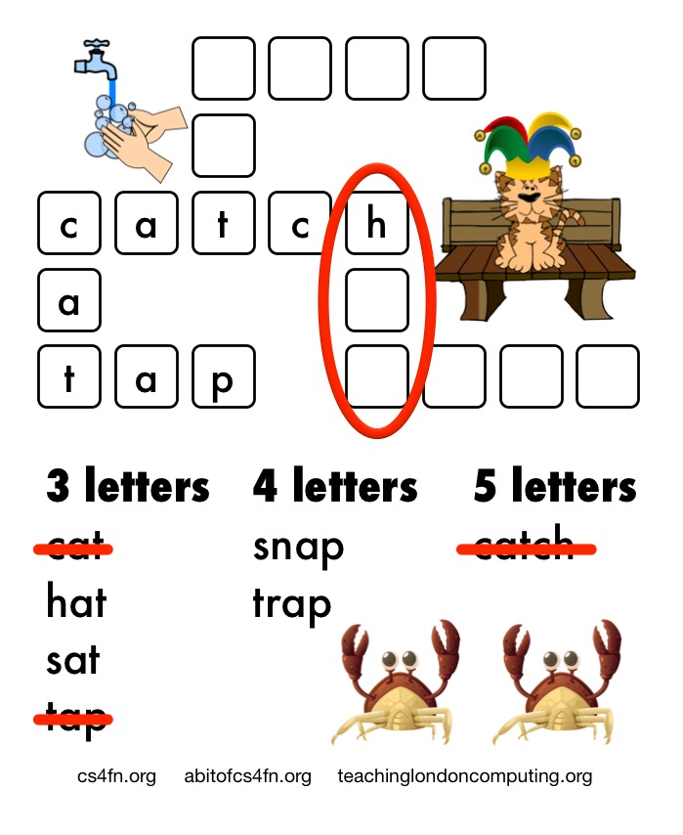
Fill in the word and cross it off
Then find the next clue in the grid
There is still that h we left

Slide 14
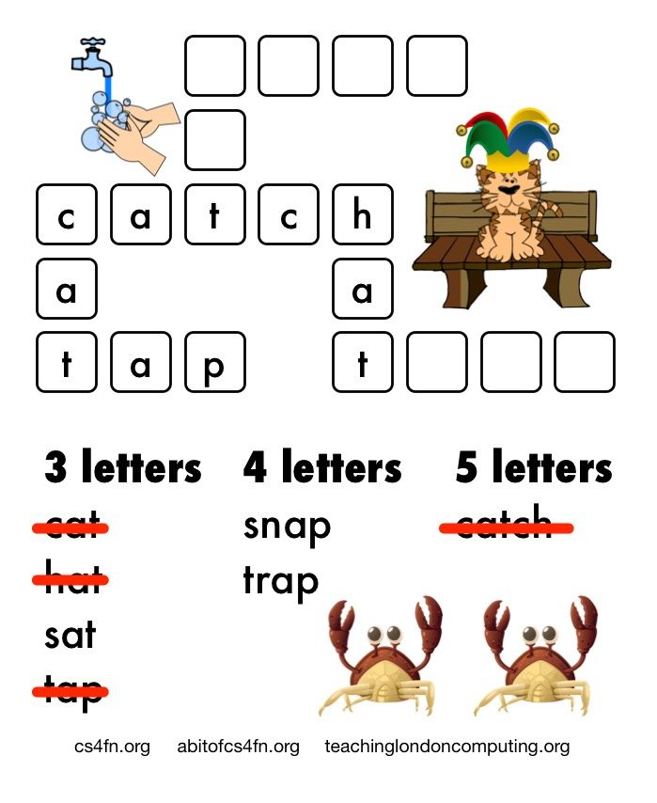
The only three letter word that starts with h is hat
Fill in the word and cross it off

Slide 15
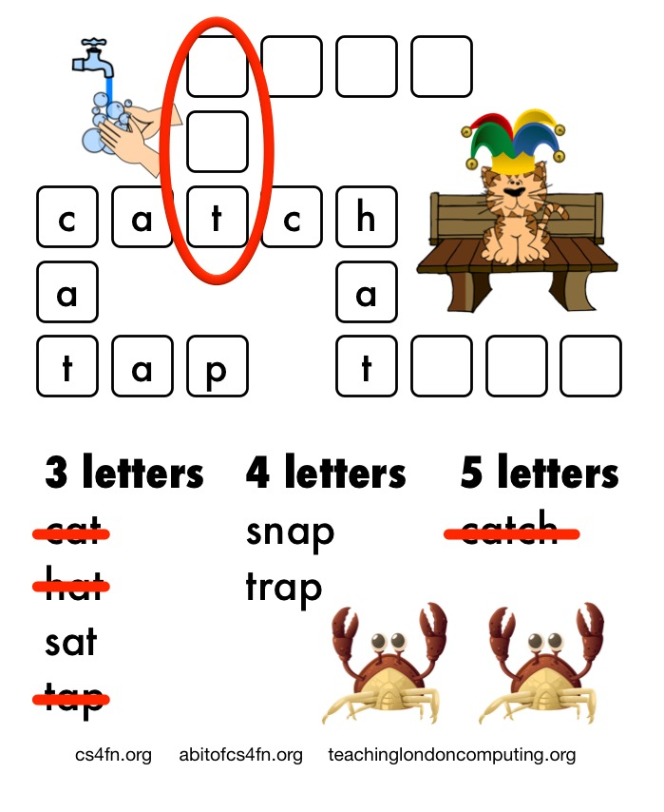
That pesky 3-letter word ending in t has been a problem.
Before, lots of words could have gone there.
But now only one 3-letter word is left.

Slide 16
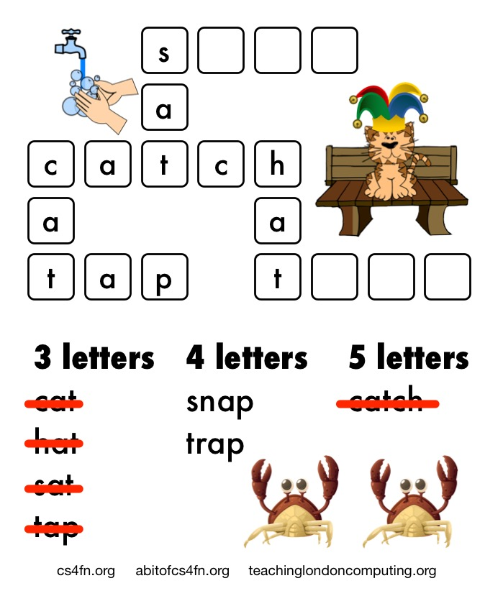
At last that clue’s time has come!
Fill in the word (sat) and cross it off

Slide 17
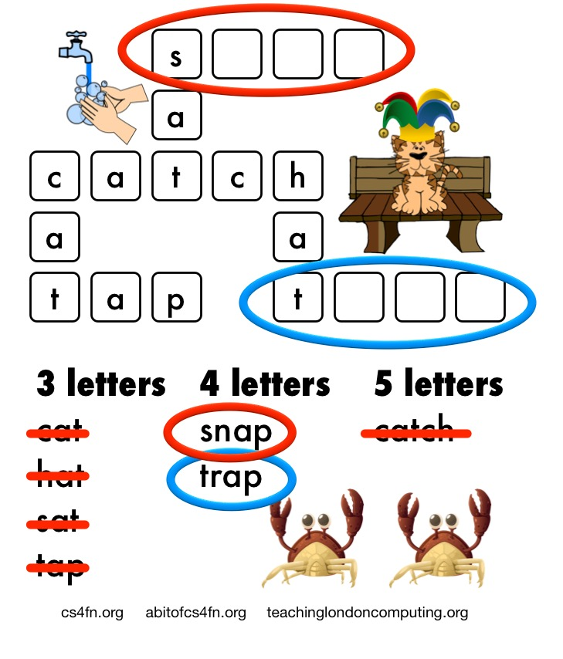
Now we only have 4-letter words left.
We could do either first.

Slide 18
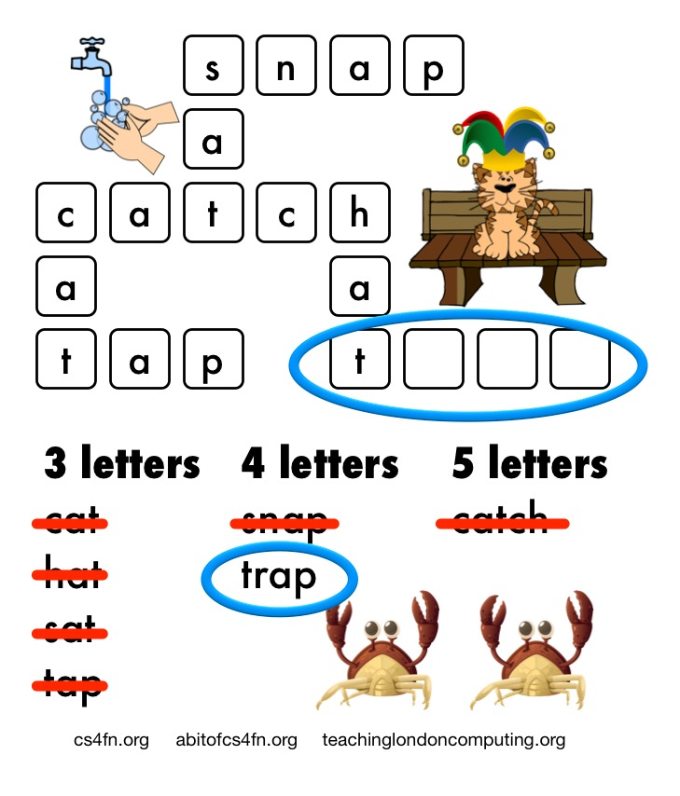
Let’s do snap first

Slide 19
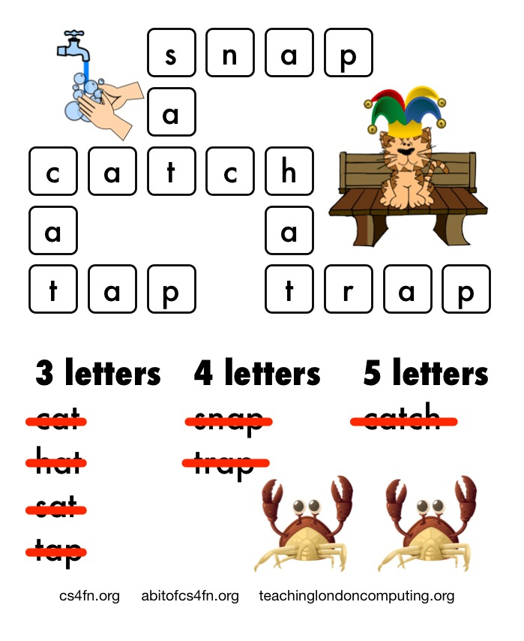
Finally we do trap
And we are done!

Slide 20
Solving Problems through Logical Thinking
Logical thinking is just about thinking clearly and being careful.
Look for clues that are useful now.
Some clues won’t be useful yet. Just be patient! You just need other clues first.
Check and double check.

