Slide 1

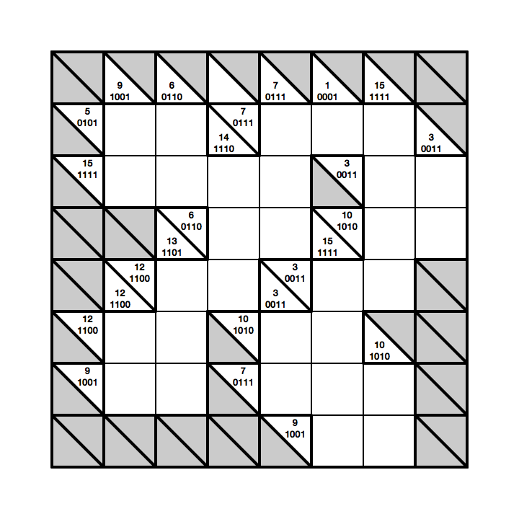
Bakuro:
Binary Logical Thinking Puzzles
Paul Curzon
Queen Mary
University of London
With support from Google,
DfE, the Mayor of London, CHI+MED
www.teachinglondoncomputing.org
www.cs4fn.org

Slide 2
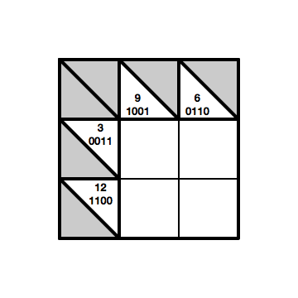
A simple example puzzle
Fill the grid using only powers of 2 (1,2,4,8)
Horizontal (vertical) blocks must add to the number on the left (above)
Fill in the binary of the answers too

Slide 3
A simple example puzzle
Each number has a unique sum
Work values out from the intersection of sums
3 = 1 + 2
9 = 1 + 8
1
0001

Slide 4
A simple example puzzle
3 = 2 + 1
6 = 2 + 4
The binary tells you the numbers!
0011 = 0010 + 0001
3 = 2 + 1
1
0001
2
0010

Slide 5
A simple example puzzle
12 = 8 + 4
6 = 2 + 4
9 = 8 + 1
Now you have the basics, do a harder version
1
0001
2
0010
8
1000
4
0100

Slide 7
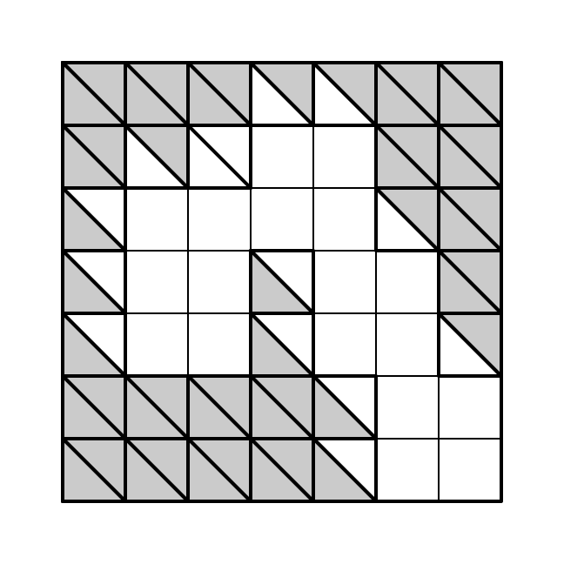
Extension Activity
Get the students to invent their own based on blank grids
They must check it is solvable!
Then create ones from a blank sheet of squared paper

Slide 8

Summary
Learn fundamentals of binary and logical thinking
Lots of practice at binary
  more fun than lists of binary-decimal conversions to do
  also focusses on underlying construction
Puzzles are a good way to explore and learn many computing and computational thinking ideas

Slide 9
More support
On our website contains:
Activity sheets
Booklets
Slides
Lots more stories
For teachers: www.teachinglondoncomputing.org
For students: www.cs4fn.org
Twitter: @TeachingLDNComp @cs4fn

