Slide 1
How the Session Works
Outline
Practical on arrival
Talk 1
  Reflect on practical
  Clarify concepts
Practical exercises at your own pace
Talk 2:
  Further concepts
  Overall reflection
Continue practical exercises at home
Getting Started
Log-on
Find portable Python on L:\ drive and start IDLE
Go to https://scratch.mit.edu/
Find resources on teachinglondoncomputing.org
  Exercise sheet (and notes) – START NOW
  Example programs
  Slides

Slide 2

KS3 and Beyond
Transition from Scratch to Python using Turtle Graphics
Teaching London Computing
William Marsh
School of Electronic Engineering and Computer Science
Queen Mary University of London

Slide 3
Outline
A first turtle program in two languages
Discussion: barriers to textual programming
Learning Programming Progressively
The turtle language
Translating between Scratch and Python
Practical examples
Summary

Slide 4
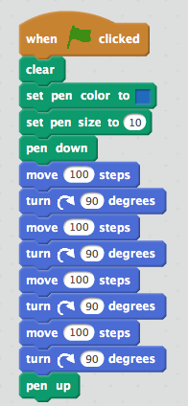
First Program
from turtle import *
# Added code starts here
pencolor('blue')
pensize(10)
forward(100)
right(90)
forward(100)
right(90)
forward(100)
right(90)
forward(100)
right(90)
# Added code ends here
done()

Slide 5
Discussion
What are the challenges of learning textual programming?

Slide 6
Challenges of Text Programming
Accuracy – easy to make mistakes
Blank sheet problem – lack of starting point
Motivation – not visual
Solving a problem: decomposition
Understanding programming concepts
  Sequence, choice, repetition, state (variables)
Debugging

Slide 7
Progress in Learning Programming
KS1 onwards
  Computers accept commands: algorithm
  … turtle often used
  Decomposition: sequences, choice and repetition
Challenges
  Learning Scratch versus learning programming
Core concepts
  Problem solving and debugging
  Programming concepts

Slide 8
Core Programming Concepts
Sequence: one instruction follows another
State: variables hold values and can change
Choice: alternative instructions
Repetition: repeating instructions
Input and output
Values (expressions) versus statements
Abstraction: procedures / functions

Slide 9
Turtle Language – I
Role of turtle in Scratch and Python
  Turtle is a little language inside a more general language
Essential commands
  Forward
  Left
  Right
  Pen up
  Pen down
General language concepts
Sequence
Repetition (bounded)
Function abstraction

Slide 10
Turtle Language – II
Use of co-ordinates and headings
Get and set co-ordinates
Get and set heading
Also
  Distance
  Towards
General language concepts
Variables
Choice

Slide 11
Translating Scratch & Python
Same core concepts
Overlapping problems that can be easily solved

Slide 12
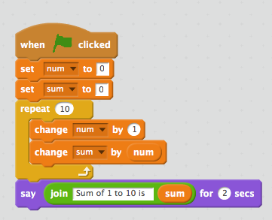
Comparing Shapes and Text
No punctuation or spelling errors
Direct representation of inside loop
  Indentation (Python)
  Brackets (C, Java, …)
num = 0
sum = 0
while x <= 10:
x = x + 1
sum = sum + num
print('Sum … is', sum)

Slide 13
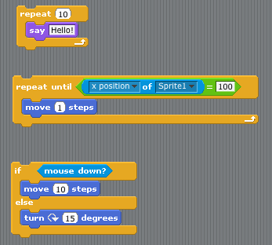
Control Statements – Close
for x in range(1, 10):
print(“Hello”)
x = 0
while x != 100:
forward(1)
if mouseDown():
forward(10)
else:
right(15)

Slide 14

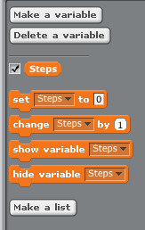
Variables – Set and Change
Later in scratch
Variables:
Sprite
Global
Value of the variables
Python uses name for both left and right hand side of assignment
Steps = 0
Steps = Steps + 1

Slide 15
Programming Concepts
Concept | Comparison
Arithmetic operators | Very similar
Logical operators | Very similar
Selection | Very similar
Loops | Scratch has more forms
Variables and types | Scratch does not distinguish strings from numbers
Assignment | Clearer in Scratch
Input and output | Scratch equivalents for input / print
Broadcast | No direct equivalent: decomposition
Functions | Similar
Sprites | No direct equivalent

Slide 16

Introduce Assignment
Exploit different syntax to emphasise that assignment is not equality
Python
Means the same as:
Total = Total + ItemCost * Number

Slide 17
Practical Problems

Slide 18
Equivalence
Two programs can have same behaviour
  Different forms of ‘if’ or ‘loop’
  Logical equivalence
  Repetition versus loops
Redundant code
  Code that makes no difference
  Easy to include this in Scratch

Slide 19
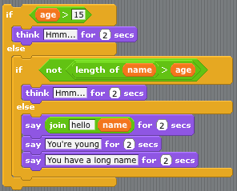
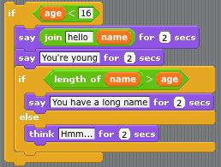
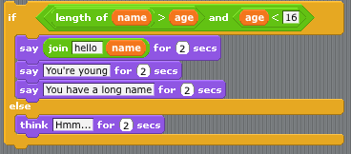
Problem 1: If & Logic
Two variables: 'name and 'age'
Which versions are the same?

Slide 20
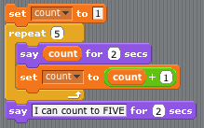
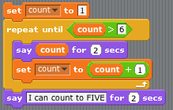
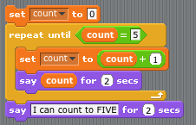
Problem 2: Counting to 5
Which are the same?

Slide 21
Summary
Ideas for transferring from visual to textual programming
Core programming concepts: make the correspondence explicit
Problem solving, abstraction and decomposition: build on existing ideas

