Slide 1
How the Session Works
Outline
Practical on arrival
Talk 1
  Reflect on practical
  Clarify concepts
Practical exercises at your own pace
Talk 2:
  Further concepts
  Overall reflection
Continue practical exercises at home
Getting Started
Log-on
Find portable Python on L:\ drive
Start IDLE
Find resources on teachinglondoncomputing.org
  Exercise sheet (and notes) – START NOW
  Example programs
  Slides

Slide 2
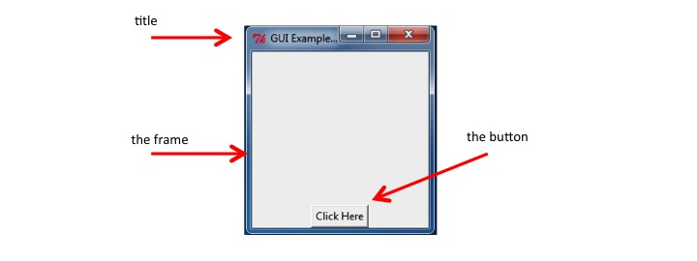
First Program – Click the Button
Code provided but not yet explained
Use ‘pattern matching’ (i.e. intelligent guessing) to modify it

Slide 3

A Level Computer Science
Programming GUI in Python
Teaching London Computing
William Marsh
School of Electronic Engineering and Computer Science
Queen Mary University of London

Slide 4
Outline
A first program
Concepts in Graphical User Interface
  Components / widgets and attributes
  Events / actions
  Layout
Practical examples
Challenges of GUI programming
  Choosing a GUI library
  Using Object-Oriented programming

Slide 5
Key Concepts
Explained Using the Button Example

Slide 6
Key Concepts
A widget / component
  E.g. a button, a frame
  Attributes e.g. the button text
Actions
  E.g. what happens when you press the button
Layout
  Positioning widgets

Slide 7
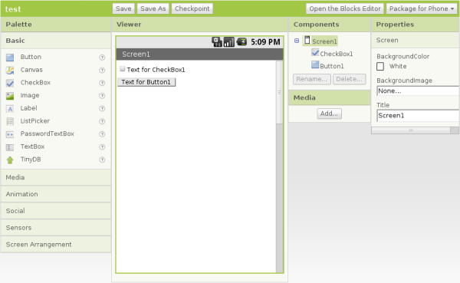
AppInventor
Code for events
Hierarchy of components
Widgets, called components
Attributes called properties

Slide 8
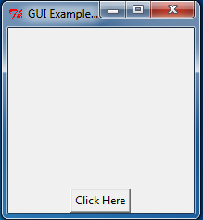
Widgets
A GUI is made up
from widgets
A widget is created
Widget has attributes
One widget may contain
another:
  Frame contains the button
frame
button

Slide 9
Create a Widget
Constructor
  Name same as widget
  Hierarchy of widget
  Optional arguments
# Create a main frame with
# - a title
# - size 200 by 200 pixels
app = Tk()
app.title("GUI Example 1")
app.geometry('200x200')
Constructor
Optional argument
Parent widget
# Create the button
# - with suitable text
# - a command to call when the button is pressed
button1 = Button(app, text="Click Here", command=clicked)

Slide 10
Widgets have Attributes
E.g. a name, size
Any property of the widget that makes it specific
# Create a main frame with
# - a title
# - size 200 by 200 pixels
app = Tk()
app.title("GUI Example 1")
app.geometry('200x200')
Attributes set by constructor (note use of keyword arguments)
Methods to set attributes
# Create the button
# - with suitable text
# - a command to call when the button is pressed
button1 = Button(app, text="Click Here", command=clicked)

Slide 11
How to Set / Get an Attribute
Method 1 (setting):
  Set value with the constructor
Method 2 (setting and getting):
  Widget is a dictionary
Method 3 (sometimes)
  Call a suitable method
# Change button text
mText = button1['text']
button1['text'] = mText.upper()
Other methods exist

Slide 12
Aside: Dictionaries
Dictionary: a map from a key to a value
  Unique key
  Built in (Python) versus library (many other languages)
Standard Array | Python Dictionary
Index by number | Key can be a string, pair, …
Indices continuous e.g. 0 → 10 | Gaps ok
Holds only number, character | Any value – even a dictionary
# Change button text
mText = button1['text']
button1['text'] = mText.upper()
Lookup
Update

Slide 13
Handle an Event
# This method is called when the button is pressed
def clicked():
print("Clicked")
# Create the button with
# - a command to call when the button is pressed
button1 = Button(app, text="Click Here", command=clicked)
Events
  Button, mouse click, key press
Action
  Event ‘bound’ to function
Name of a Method

Slide 14
Layout the Widget
# Make the button visible at the bottom of the frame
button1.pack(side='bottom')
Where does the widget go?
  Hierarchy
  Top-level window
Layout manager
  Several available
  Problem of resizing
The ‘pack’ layout manager is simplest
Widget is not visible until packed

Slide 15
A Minimal Application
# Import the Tkinter package
# Note in Python 3 it is all lowercase
from tkinter import *
# Create a main frame
app = Tk()
# Start the application running
app.mainloop()
import with prefix
# Import the Tkinter package
# Note in Python 3 it is all lowercase
import tkinter as tk
# Create a main frame
app = tk.Tk()
# Start the application running
app.mainloop()
Loop to handle events

Slide 16
(Some) tkinter Widgets
Widget | Use
Button | A button
Canvas | For drawing graphics
Entry | Entry a line of text
Frame | A rectangular area containing other widgets
Label | Display a single line of text
Menu | A set of options shown when on a menu bar
Radiobutton | Select one of a number of choices
Scrollbar | Horizontal or vertical scrolling of a window
Text | A multi-line text entry
Toplevel | A top-level frame

Slide 17
Further Practical Exercises
See exercise sheet
A sequence of exercises introduce other widgets and apply the core concepts
… probably too many to finish now
You may also need to refer to the notes at the end

Slide 18
Further Concepts
Dialog
Top-level window
Control variables

Slide 19
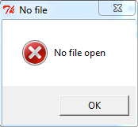
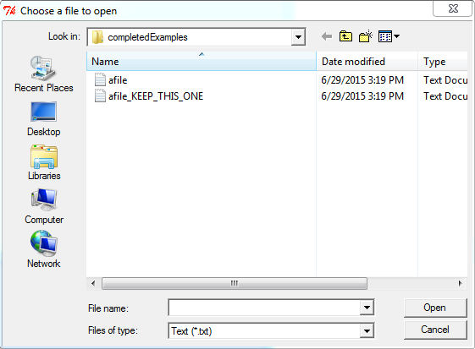
Dialogs
You must respond to a dialog
  Messages
  File choosing

Slide 20
Top-Level Windows
At least one top-level window
  Conveniently created using Tk()
  Like a frame but …
Menu bar
Standard buttons
Borders

Slide 21
Control Variables
Variables linking
  Entry widget to its text
  Choices in a RadioButton
These are objects in the framework

Slide 22
Challenges in GUI
Which framework?
How to design a GUI
How much OOP?

Slide 23
GUI Framework
A GUI framework defines a set of widgets
  Windows has it’s own GUI framework
Python uses a portable GUI framework
  tkinter, depends on Tk and TCL
  PyQT, depends on QT
Tkinter
  Pro: simple, easy to install
  Cons: a bit limited; documentation weak
PyQT: more complex

Slide 24
Designing a GUI
What am I trying to do?
What widgets do I need?
  Where will they go?
  How do they behave?

Slide 25
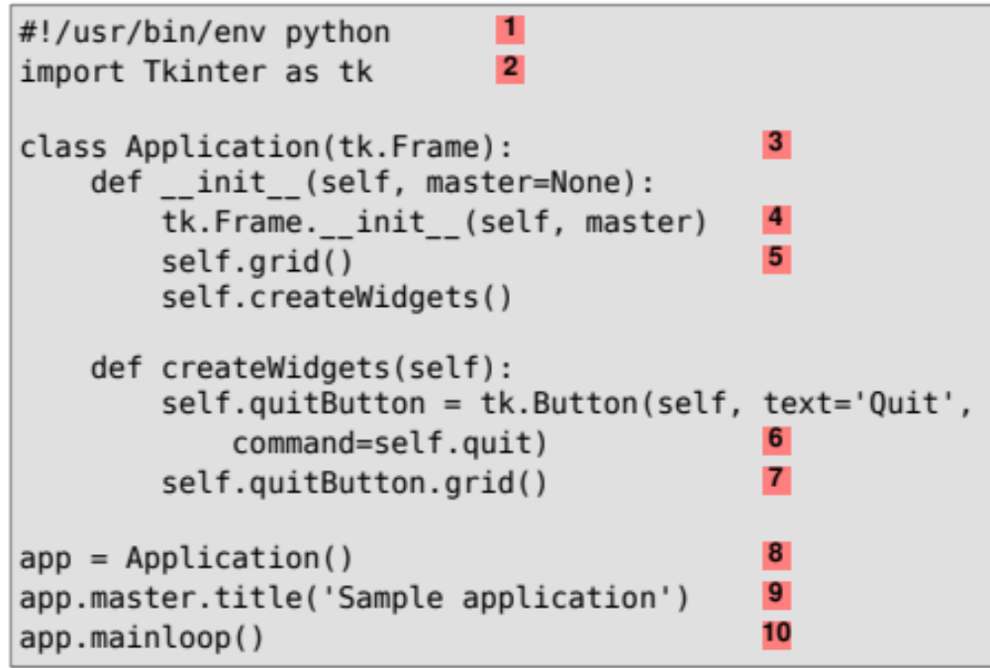
The OOP Problem
Why OO and GUI
  Widgets are classes
  Default behaviour
GUI programs are
often organised
using classes
Practical Problem: most examples use OOP

Slide 26
Summary
Core concepts common to all framework
Understand principles
Learn about available widgets
Look up attributes and methods
After programming … interface design

