Slide 1

Programming for GCSE
Topic 5.2: Memory, Caching and Operating Systems
Teaching London Computing
William Marsh
School of Electronic Engineering and Computer Science
Queen Mary University of London

Slide 2
From the specification
OCR GCSE Computing
Explain how common characteristics of CPUs such as … cache size and …
Explain the need for the following functions of an operating system: user interface, memory management, peripheral management, multi-tasking and security
AQA GCSE Computer Science
Be able to explain the effect of common CPU characteristics on the performance of the processor. These should include … cache size/types …

Slide 3
Outline
Memory overview
Understanding performance
  Latency versus Bandwidth
  How a cache works
What is an Operating System for?

Slide 4
Types of Memory

Slide 5
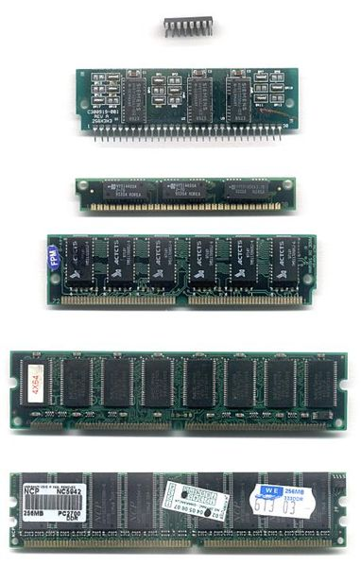
Semiconductor
RAM
  Volatile
  Dynamic or static
ROM
  Non-volatile
  Maybe eraseable
Flash
  Non-volatile
  Limited life
What is ROM used for?

Slide 6
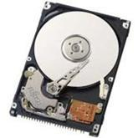
Disk
Capacity: GBytes
RPM: how fast it spins (RPM)
Size (diameter – in): how big?
Interface: will it work in my PC?
Buffer size (it's a cache): MBytes
Bandwidth (peak, sustained): MByte/second
Performance?

Slide 7
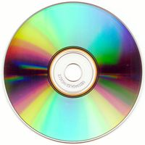
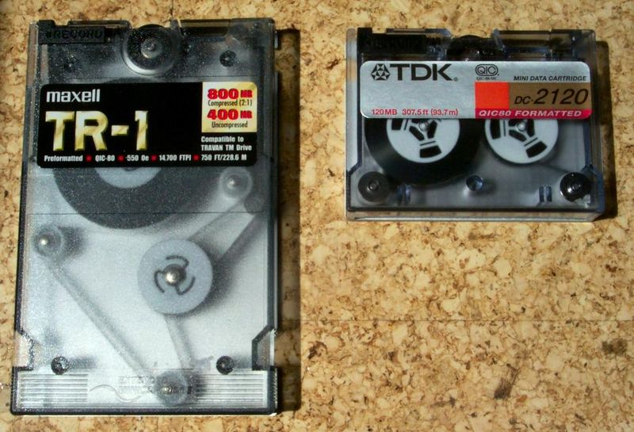
Optical and Tape
Tape
  Magnetic
  Re-writeable
  Serial access
CD-ROM
DVD
  Distribution
  Backup
  Read-only or read/write
Notes:
http://en.wikipedia.org/wiki/Image:Quarter-Inch_Cartridges.jpg
http://en.wikipedia.org/wiki/DVD

Slide 8
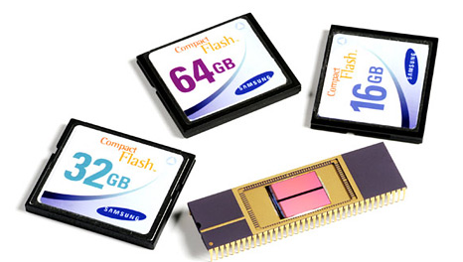
Trends
Tape is on the way out
  Capacity no longer exceeds disk
  Price / byte no longer less than disk
Disk being replaced by Flash
  Flash only devices:
  e.g. iPad, RPi, most phones
  Solid state – 'faster'

Slide 9
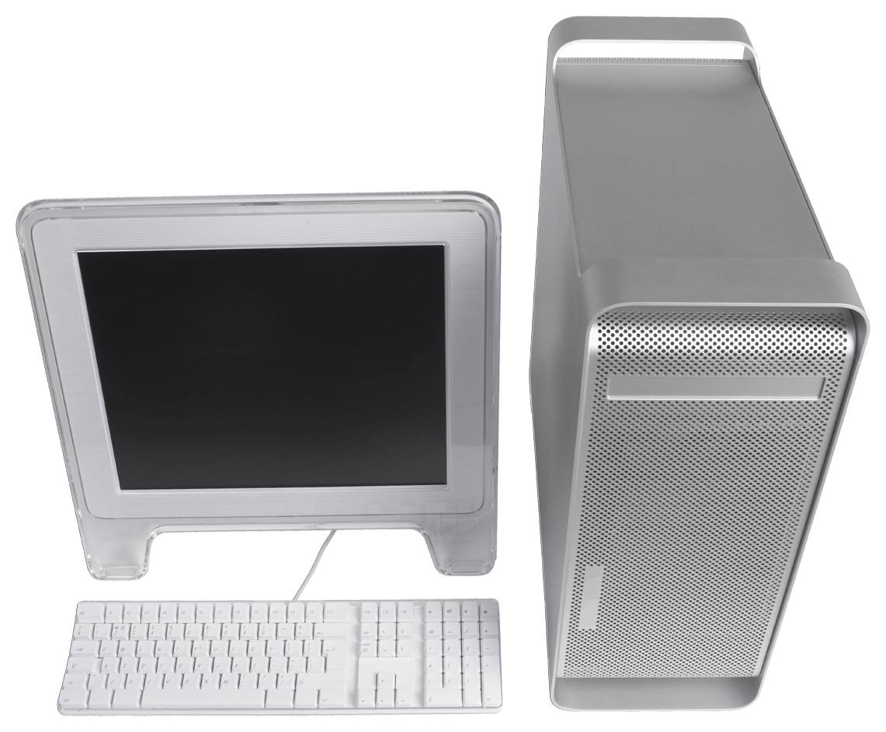
Storage Over a Network
Shared storage
  Local network – e.g. around office
  Internet – e.g. dropbox
Bandwidth: network must be
  ~ as fast as disk
  Not too far away

Slide 10
Storage Characteristics
Capacity – Bytes
  Cost per byte (disk is cheapest)
Volatile / non-volatile (permanent)
  RAM is volatile
Access
  Random – anywhere (RAM)
  Sequential – only in sequence (tape)
  Block – hard disk
Speed – latency and/or bandwidth

Slide 11
Understanding Performance
Latency versus bandwidth
How does a cache work?

Slide 12
Latency versus Bandwidth
Wait for the bus versus how quickly it goes
Bandwidth: is rate of data – Bytes / sec
  Can be increased
Latency: is delay – seconds
  Speed of light (c) – 3 x 10⁸ m/s
  Fibre-optic / electrical signals go at ~1/2-1/3 c
Distance | Time | Example
30cm | 1ns | 1 tick of the CPU clock
30m-300m | 100ns-1μs | Distance to school file server
6000Km | 20ms | Distance to USA
30,000Km | 100ms | Distance to a geostationary satellite

Slide 13
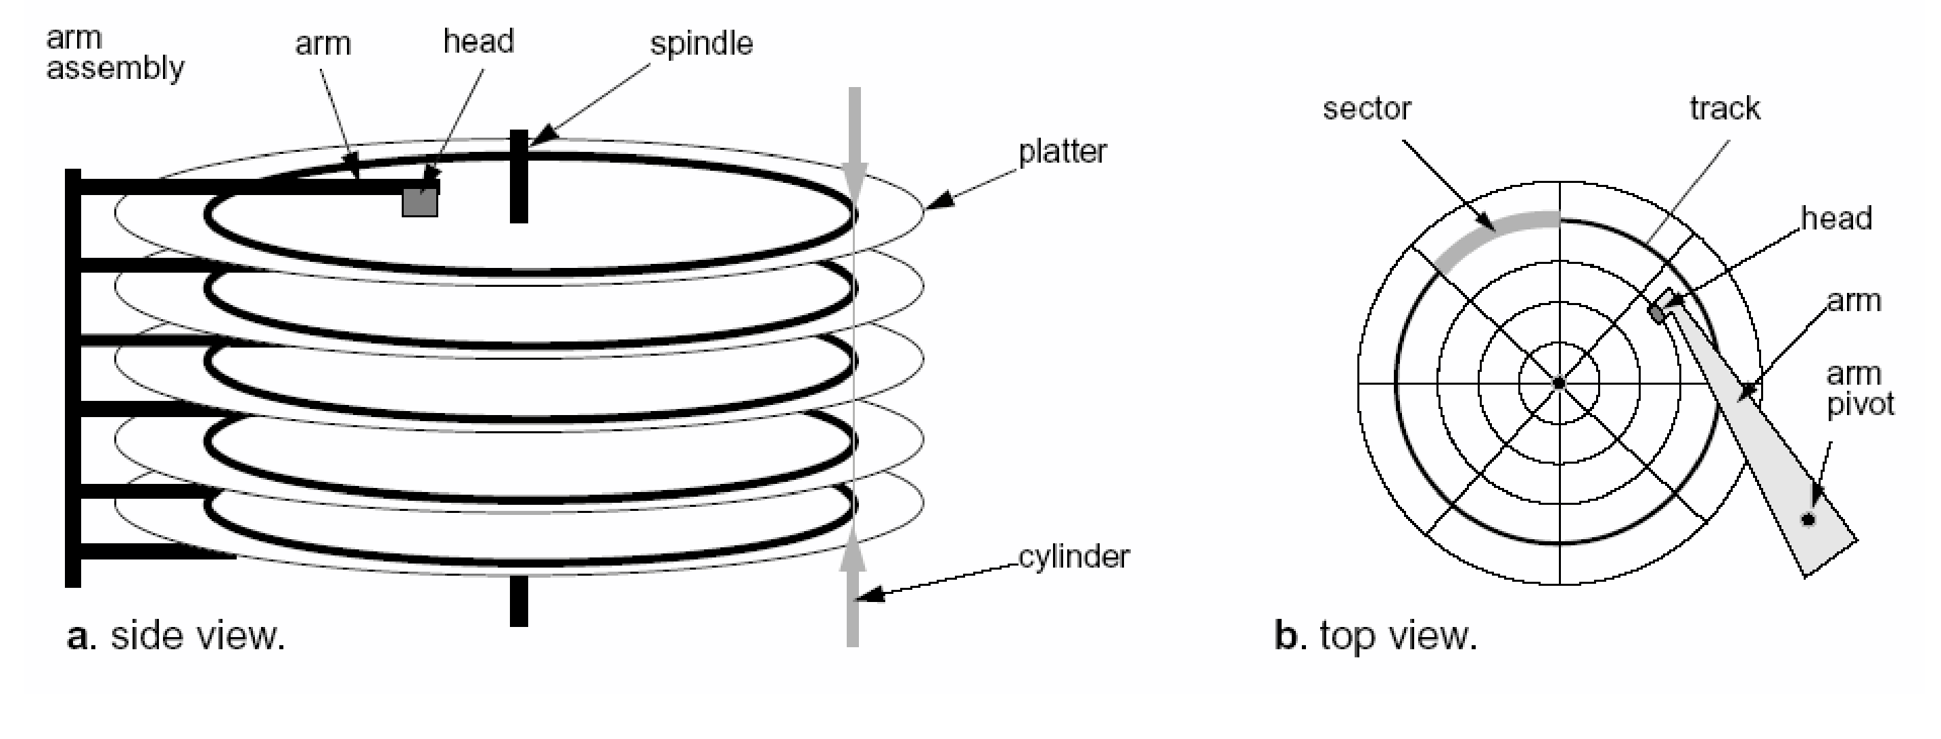
How Does a Disk Work?
Disk spins e.g. 100 times/sec (6000rpm)
Reading head moves
  Track: ring around the disk surface

Slide 14
Disk and Memory Latency
Latency of the disk
  1 rotation every 10ms (100x a second)
  Average wait 5ms (= 5,000,000 cpu instructions)
  … also arm movement
Memory Type | Delay (CPU cycles)
RAM | 10 or more
SSD (Flash) | 1,000s
Disk | 1,000,0000s

Slide 15
What's a Cache?
Small fast memory
Copy of part of a larger slower memory
Word transfer
Block transfer
chip
Main
Memory
CPU
Cache
Can keep up with CPU
10-20x slower than CPU

Slide 16
Lots of Caches in a Computer
Main memory cache
  Hierarchy: L1 (small & fast), L2, L3 (larger & less fast)
Disk cache
  RAM in the disk drive
File buffer
  Read block of file into memory
  Buffer writes too

Slide 17
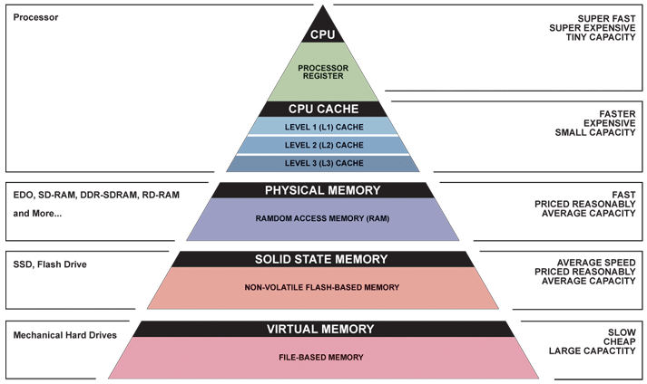
Memory Hierarchy
Trade-off cost, capacity and speed

Slide 18
What’s An Operating System For?
Input and output
Organising files
Managing processes and memory

Slide 19
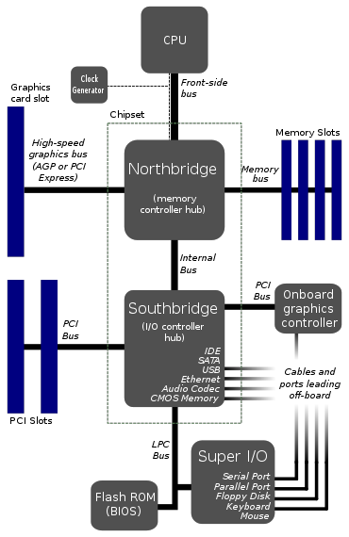
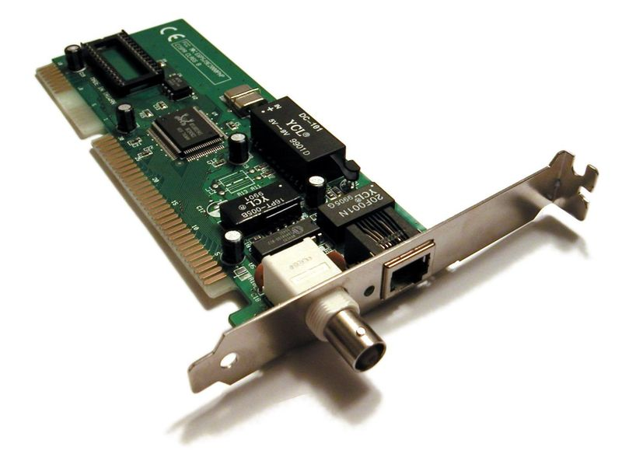
Manage I/O Buses and Drivers
I/O cards on buses
  How to move data?
Interface standards
  PCI, USB, SATA
Device drivers

Slide 20
File Systems
Files organised into directories
Hierarchy
Ownership and protection
Attributes
  Size
  Dates
Illusion: disk is organised into file

Slide 21
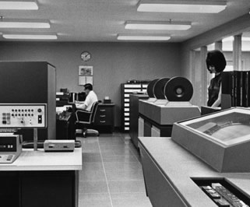
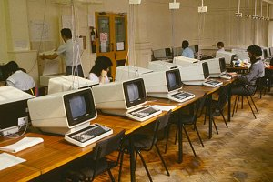
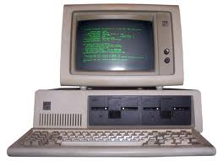
History
Mainframes
  Multi-programming
  Time sharing
Personal computer
  Now with Mainframe OS
Large computers
One Program
Many Programs
… & many users
Small
computers

Slide 22
Processes
It’s Quicker to Run Several Programs at Once
  A single program must wait for the disk
  Several programs improves throughput
Multiple processes on one processor
  An illusion …
  … created by juggling
But there are consequences …
Multi-tasking
Scheduling

Slide 23
Memory
Memory Management
Lots of process ➔ sharing memory
Where in memory is my code and data?
  No reserved place
Who get the memory?
Virtual memory
  Illusion: your program can use all the memory
  Illusion: the computer has as much memory as you want

Slide 24
Memory – Where?
Is your data in cache or main memory?
What happens when the programs overfill memory?
The OS
‘hides’ this
from the
programmer

Slide 25

Interrupts
I/O device speed varies
How many CPU clock cycles per keystroke?
How to avoid CPU waiting for I/O?
Interrupt
  Signal from outside the CPU
  … changes the program

Slide 26
OS is about Illusions
Several programs are running simultaneously
  The computer switches from one to another
My program has all the memory
  The memory is shared between programs
Disk is organised in files
  The disk has blocks; the OS maps file names to blocks
Storage devices work the same
  Files may be arranged differently on magnetic, flash and optical drives
OS creates an ‘ideal’ computer from a real one

Slide 27
Computer Layers
Each layer solves a problem
GUI
Shell
Application
Processes
Files
Operating System
Networks
Binary data
Binary code
CPU
RAM
Disk, I/O
Logic Gates

Slide 28
Summary
Storage characteristics
  Capacity and cost
  Volatile / permanent
  Access: random, block, sequential
Performance
  Bandwidth – rate of data
  Latency – delay for data
  A cache reduces (effective) latency
Operating System creates illusions
  Standard I/O interfaces
  Process and memory management

