Slide 1

Programming for GCSE
Topic 5.1: Computer Components
Teaching London Computing
William Marsh
School of Electronic Engineering and Computer Science
Queen Mary University of London

Slide 2
Aims
Overview of computer components
Example: Raspberry Pi
The Universal Machine
Performance: Clocks and Cores

Slide 3
From the specification
OCR GCSE Computing
Explain how common characteristics of CPUs such as clock speed, cache size and number of cores affect their performance.
AQA GCSE Computer Science
Understand how different components link to a processor (ROM, RAM, I/O, Storage, etc)
Be able to explain the effect of common CPU characteristics on the performance of the processor. These should include clock speed, number of cores …
AQA GCSE Computer Science
Be able to categorise devices as input or output depending on their function

Slide 4
Computer Components

Slide 5
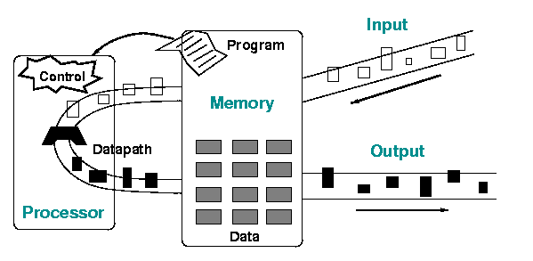
Computers
Principal components of a computer
  Processor
  Memory
  Input and Output

Slide 6
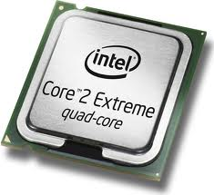
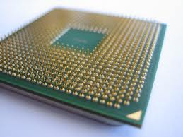
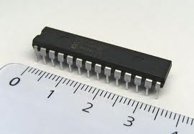
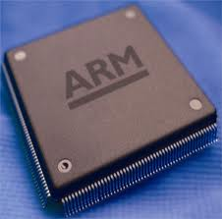
Processor
The part that does the calculation
Notes:
Small processors that are

Slide 7
CPU
Instructions and data read from memory
Results written to memory
Memory
Instruction
Register
Registers
Data
Control
Unit
ALU
Program

Slide 8
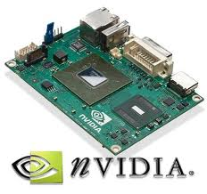
Graphics Processing Unit (GPU)
Another computer
  Separate card → same chip
Best for graphics calculations
  Games
  Frame rate

Slide 9
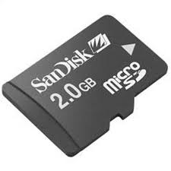
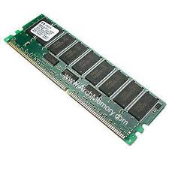
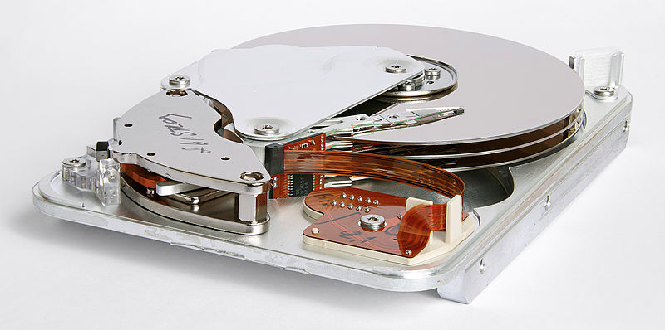
Memory
Lots of different types
Volatile versus permanent
Size and performance

Slide 10
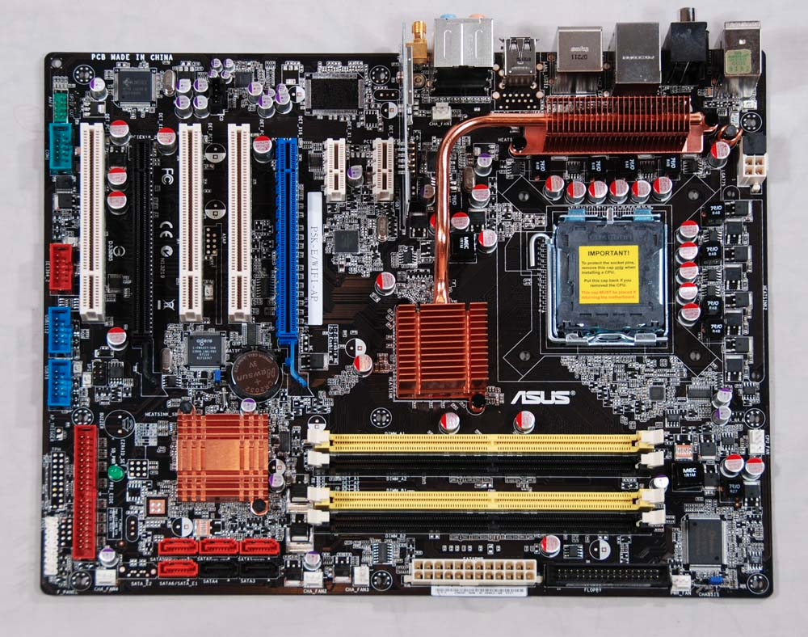
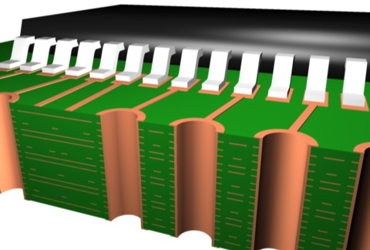
Motherboard
Joins everything together
Standards
Wires inside

Slide 11

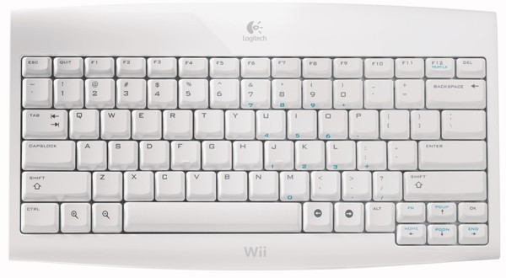
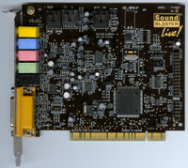
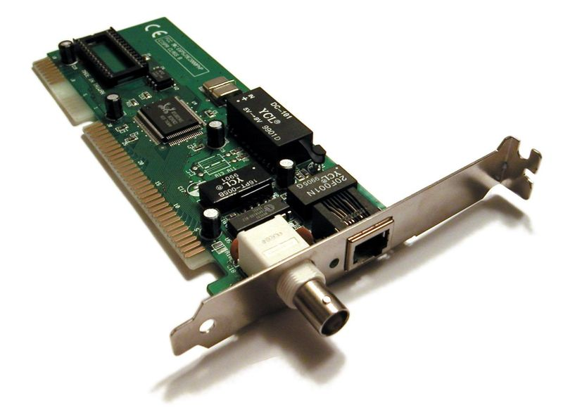
Interface Devices and Cards
ISA bus Ethernet card
PCI sound card
  Sound blaster live!

Slide 12
Raspberry Pi
Complete small computer
Similar to a mobile phone

Slide 13
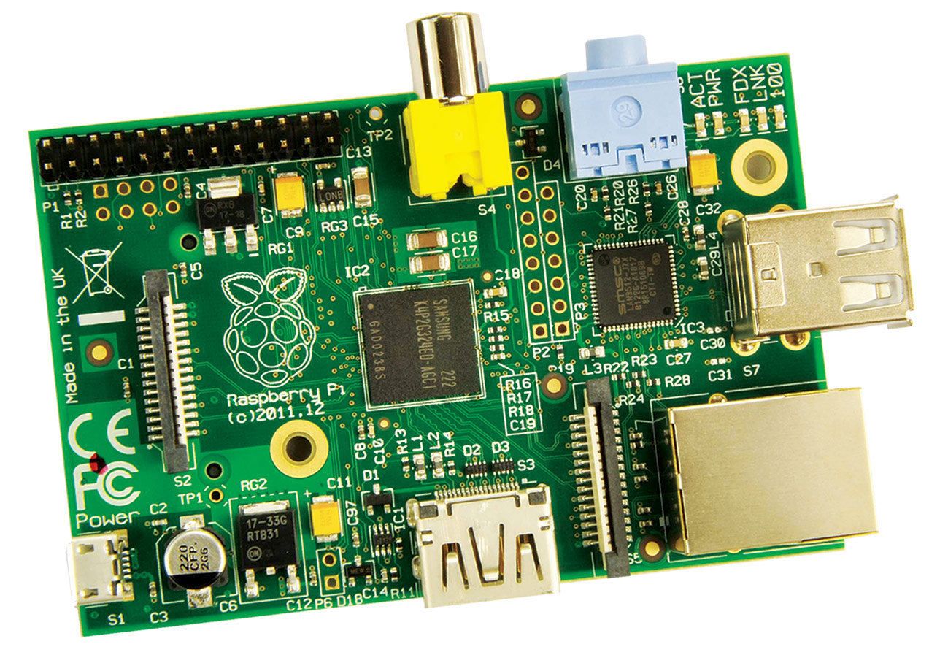
SD Card (under here)
Memory, CPU, GPU

Slide 14
GPIO
Ethernet controller
USB sockets
Power:
5V, 1 A
Ethernet socket

Slide 15
Composite video
DSI Display I/F
Audio
Camera connector
HDMI
socket

Slide 16
Universal Machine
The Idea of a Stored Program Computer

Slide 17
What’s a Computer?
Memory
Instruction
Register
Registers
Data
‘Do anything’
  With a program
‘Do nothing’
  Without a program
Embedded computers
  Control, toys
Control
Unit
ALU
Program
Program is data

Slide 18
Clocks and Cores

Slide 19
Clock Speed and Moore’s Law
CPU repeats the same cycle:
  Fetch: gets the next instructions
  Execute: move data according to the instruction
Clock ‘conducts’ this cycle
  First IBM PC ~ 8MHz
  Today ~ 2 GHz
Greater speed → more instructions per second
Moore’s law → smaller
  … in the past this has meant faster

Slide 20
Pipelines and Cores
Moore’s law → more transistors
Idea 1: pipeline
  Like a factory
  More instructions / sec
Idea 2: superscalar – parallel pipelines
Idea 3: many CPU (cores)
  Share memory
Multiple cores do not make 1 program faster
CPU Stages
Instructions →
Stage: 1 2 3 4 5

Slide 21
Summary – Computer
Stored program computer
Processor(s) – CPU and GPU
Memory
  Data and program
Storage
Idea of a universal machine
  Computer + program
Clock speed
  2 GHz → 2 x 10⁹ instructions per second

