Slide 1

Topic 1.2: Python
Numbers and Strings
Teaching London Computing
William Marsh
School of Electronic Engineering and Computer Science
Queen Mary University of London

Slide 2
Aims
Understand values that can be used in Python
  Numbers
  Strings
Write expressions using numbers and strings
Understand why some expressions give errors
Try out the example in this topic using the Python shell

Slide 3
Values – Numbers
Python can work with numbers
Integers: 10 20 12345
Decimals: 7.2 -0.00134

Slide 4
Values – Strings
A string is a sequence of letter
  ’David Cameron’
  ”David Cameron”
Either single or double quotes can be used but must be the same at either end
  This allow quote characters in strings

Slide 5
Arithmetic
Python does arithmetic using operators:
Operation Meaning
x + y sum of x and y
x - y difference of x and y
x * y product of x and y
x / y x divided by y
x // y integer division of x by y
x % y remainder of x / y
-x x negated
+x x unchanged
pow(x, y) x to the power y
x ** y x to the power y

Slide 6
Arithmetic
Brackets can be used:
  10 – 5 – 2 = 3 left to right order
  10 – (5 – 2) = 7 … as in maths
Two kinds of division
  10/4 = 2.5 real (floating point) division
  10//4 = 2 integer division
The ‘%’ operator mean remainder
  10 % 3 = 1

Slide 7
String Concatenation
Python can join strings together
Notice that the same operator ‘+’ has two different uses
  Adding numbers
  Joining string
’Hello’ + ’World’ gives ’HelloWorld’
’Hello’ + “ ” + “World” gives ’Hello World’

Slide 8
Indexing and Slicing Strings
Indexing get a character from a string
  "william"[0] – gives ‘W’
  "william"[1] – gives ‘i’
  "william"[6] – gives ‘m’
Notice that numbering starts from zero
Slicing is used to get a subrange
  "william"[1:4] – gives ‘ill’
  Notice that the slice [N:M] includes N but not M

Slide 9
String Length
You can find the length of a string using ‘len()’
  len(“William”) – gives 7
  len(“”) – gives 0

Slide 10
Finding a Character
Where is a character in a string? Use the .index() method
  “David Cameron“.index(“ “) – give 5
  “David Cameron“.index(“a“) – give 1
Note: index finds the first character
Technical Note
Why is ‘.index()’ written in a different way to ‘len()’?
‘len’ is a built in function
‘.index()’ is a method
This difference will become clearer later.

Slide 11
Errors
Python has fewer errors than other languages (e.g. Java)
  This has both pros and cons
Not everything we write makes sense
Syntax error: “I can’t understand what you are asking”
  123abc – not a number
  1 ! 3 – not an operator
  “hello – a string with no end

Slide 12
Evaluation Errors
“The text looks ok but when I try to calculate, it makes no sense”
  42 + “hello” – can’t combine a number and a string
  42 / 0 – can’t divide by zero
  “hello”[17] – can’t index beyond the end

Slide 13
Types
All values belong to a particular type
Strings
Numbers
  Integer
  Floating point
An operator works for values of the correct type or types

Slide 14
Input a Number

Slide 15
Input a Number
Input always reads a string
  Must not confuse string and number
Consider:
The result is:
#This program calculates your age next year
#... unfortunately it does not work
age = input("How old are you? ")
print("Next year you will be", age+1)
How old are you? 21
Traceback (most recent call last):
File “age-wrong.py", line 4, in <module>
print("Next year you will be", age+1)
TypeError: Can't convert 'int' object to str implicitly

Slide 16
Using the ‘int’ function
Use the ‘int’ function to convert a string (of digits) to a number
Try the corrected program:
#This program calculates your age next year
age = input("How old are you? ")
print("Next year you will be", int(age)+1)

Slide 17
Where do Functions Come From?
Python Library

Slide 18
Functions So Far
Function | Description
print | Write some output
input | Get keyboard input
len | Find length of a string
int | Convert string to integer
Where do the functions come from?
How do we find about these functions?

Slide 19
Library
Software written (and tested) by someone else for you to use in your program
Good news
BUT
  More complex than the language
  Just learn the bits you need

Slide 20
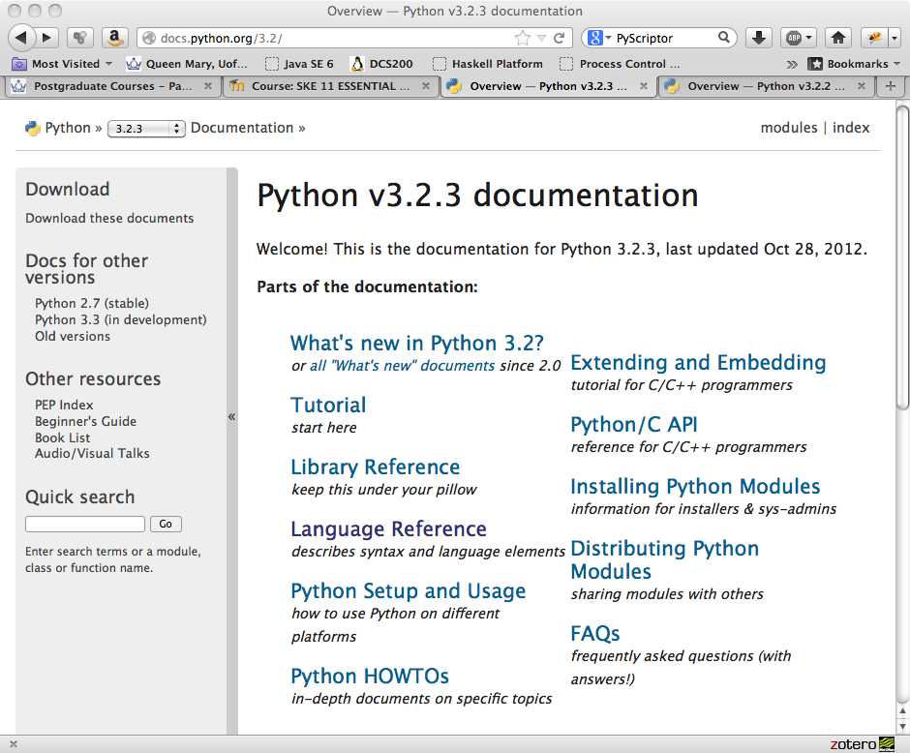

Slide 21
Built-In Functions
Look at the documentation for built in functions: http://docs.python.org/3.2/library/functions.html
  It may be available on your machine, from the IDE
Look up the functions we have already covered
  print, input, len, int
Also look at:
  min, max, ord, chr, pow, abs, bin
… and string methods
  http://docs.python.org/3.2/library/stdtypes.html#string-methods

Slide 22
Summary
Introduced some Python expressions
An expression has a value
… unless it creates an error
Some expressions are numbers
… others and string
… more to learn about.
There is a library
  Good news: lots of code for you to use

