Slide 1

Topic 1.1
First Python Program
Teaching London Computing
William Marsh
School of Electronic Engineering and Computer Science
Queen Mary University of London

Slide 2
Aims
Writing the first Python program
  Creating files
  Comments
  Layout
Using ‘print’

Slide 3
Python Program
A program is a document
  Lives in a file (best to name it with extension .py)
Much simpler than Java (or C♯)
print(”hello”)

Slide 4
Comments
Comment explain a program
Comments can be used to help plan a program
# This program prints a greeting
print(”hello”)

Slide 5
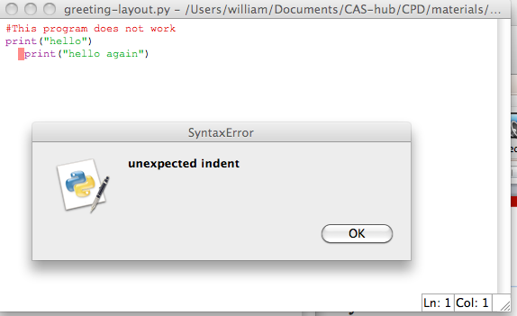
Layout
An important feature of Python
Indentation matters!
Always start in the same column

Slide 6
The ‘print’ function
The ‘print’ function is used to output strings or numbers
In these examples
  The print function has two expressions
  The expressions are printed with a space between them
print(“hello“, “world“)
print(“hello“, 99)

Slide 7
Calculation
Python can also do a calculation
Example
>>> print("Average is", (30 + 40)/2)
Average is 35.0

Slide 8
Input
A make a flexible greeting program let’s ask the name first
The output is (if you type the letter underlined):
#Greeting anyone
name = input("What's your name?")
print("Hello", name)
What's your name?William
Hello William

Slide 9
Summary
A Python program is a file containing statements
  Simple!
‘print’ for output
  String and numbers
Note
Think of print and input as a commands or instructions
Properly, they are called functions
We will soon meet other functions

