Slide 1

A Level Computer Science
Topic 3: Advanced Programming in Python
Teaching London Computing
William Marsh
School of Electronic Engineering and Computer Science
Queen Mary University of London

Slide 2
Aims
Further topics in programming
  Some Python-specific
Representing information
  Arrays of multiple dimensions
  Python built-in types: tuples, dictionaries; sequences
Exceptions: dealing with errors

Slide 3
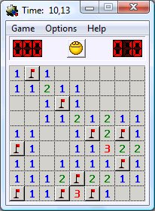
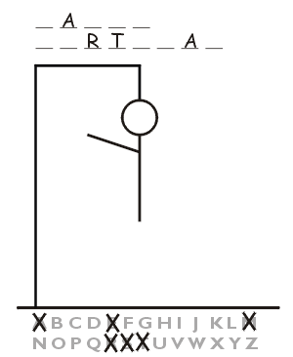
Two Representation Problems
Minesweeper squares
  Flagged / tested / hidden
  Mine / no mine
  Number of neighbouring mines
Hangman words
  Letter at each position
  Letters used
  Letters uncovered

Slide 4
Hangman Example
Representation changes program
Letter | Positions
A | 5
L | 6
N | 1
S | 3
U | 0, 2, 4
Complete word
[ 'U', 'N', 'U', 'S', 'U', 'A', 'L']
Letters guessed
[ 'A', 'E', 'T', 'S', 'R']
Current display
[ '_', '_', '_', 'S', '_', 'A', '_']

Slide 5
Arrays of Multiple Dimensions
Standard part of A Level

Slide 6
Multidimensional Arrays
Recall that Arrays are Lists in Python
So far: arrays represent
What about:
X==0, Y==1
X==2, Y==3

Slide 7
Why Arrays?
An array is a sequence of memory locations
  Simple and fundamental idea
  Really, lists are represented using arrays
We use lists to learn about arrays
Arrays | Lists
Fixed number of entries | Can be extended
All entries the same size | Can have different entries
Continuous in memory | … more complex
Regular shape | Can be irregular

Slide 8
Table of Data
Sum the columns in a table of data
Issues
  Representation
  Algorithm
10 | 27 | 23 | 32
31 | 44 | 12 | 65
15 | 17 | 18 | 23
?? | ?? | ?? | ??

Slide 9
Table Representation
Table represented by list of lists
Quiz
  table[0][1] == ?
  table[1][2] == ?
table = [ \
[10, 27, 23, 32], \
[31, 44, 12, 65], \
[15, 17, 18, 23] \
[ 0, 0, 0, 0] \
]

Slide 10
Printing a Column
Two methods
Use two indices
def printCol1(table, colN):
string = ""
for rowN in range(0, len(table)):
string += str(table[rowN][colN]) + " "
print(string)
def printCol2(table, colN):
string = ""
for row in table:
string += str(row[colN]) + " "
print(string)
Select List from Table

Slide 11
Exercise: Sum Columns
Adapt the code on the previous slide to print the sum of:
  A given column
  Of all columns

Slide 12
Built in Types in Python
Important in Python programming
Very useful
Details specific to Python; related concepts elsewhere

Slide 13
Overview
Lists – [1,2,3,4]
  Ordered collection of items; often of the same type.
  Can be changed (mutable)
Tuples – (1,2,3,4)
  Immutable ordered collection; often different types
Ranges – range(1,5)
  Number sequence; used in for loops
Sets – {1,2,3,4}
  Unordered non-repeating collection
Dictionaries – {1:'one', 2:'two', 3:'three'}
  Mappings

Slide 14
Tuples – Examples
Convenient for returning multiple values from a function
Unpack
def getTwo():
ms = input("A string> ")
nm = input("A number> ")
return((ms, int(nm)))
>>> getTwo()
A string> Hello
A number> 99
('Hello', 99)
>>> t = ("a", 1, [1])
>>> x,y,z = t
>>> z
[1]
Assign to multiple variables

Slide 15
Ranges – Examples
for x in range(1,10,2):
print("x =", x)
x = 1
x = 3
x = 5
x = 7
x = 9
In a for loop:
Convert to a list
>> list(range(0,-10,-1))
[0, -1, -2, -3, -4, -5, -6, -7, -8, -9]

Slide 16
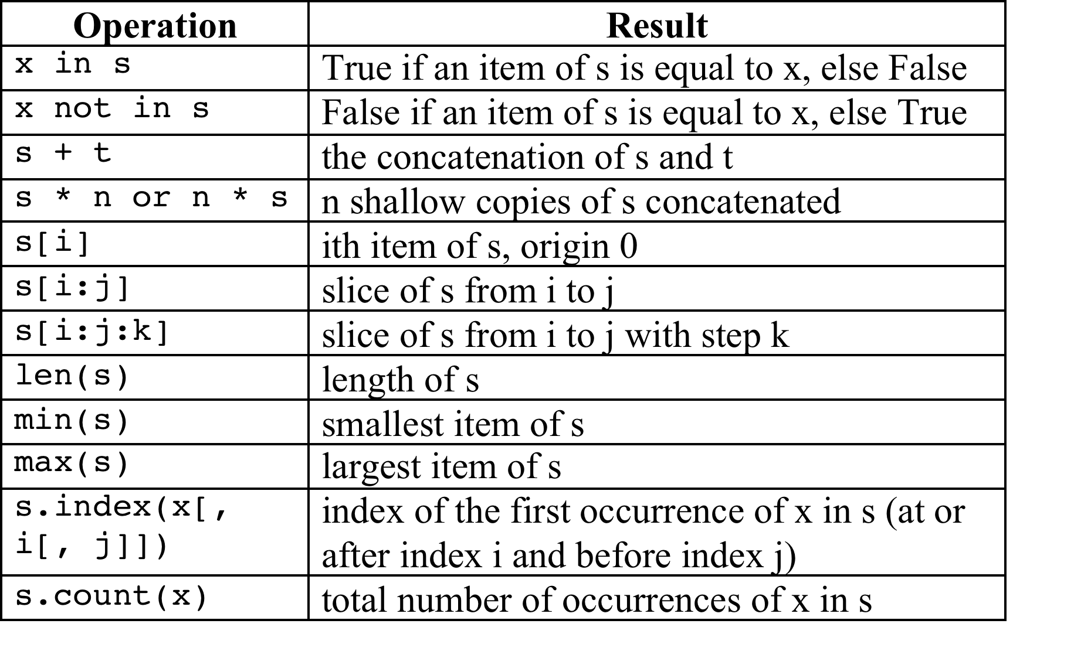
Sequences
Strings, lists, tuples and ranges are all sequences

Slide 17
Mutable and Immutable
Mutable == can change
  e.g. append an item to a list
Immutable == cannot change
  Concatenating two lists does not change them
  Copied when necessary
Lists, sets and dictionaries are mutable
Strings, tuples and ranges are immutable

Slide 18
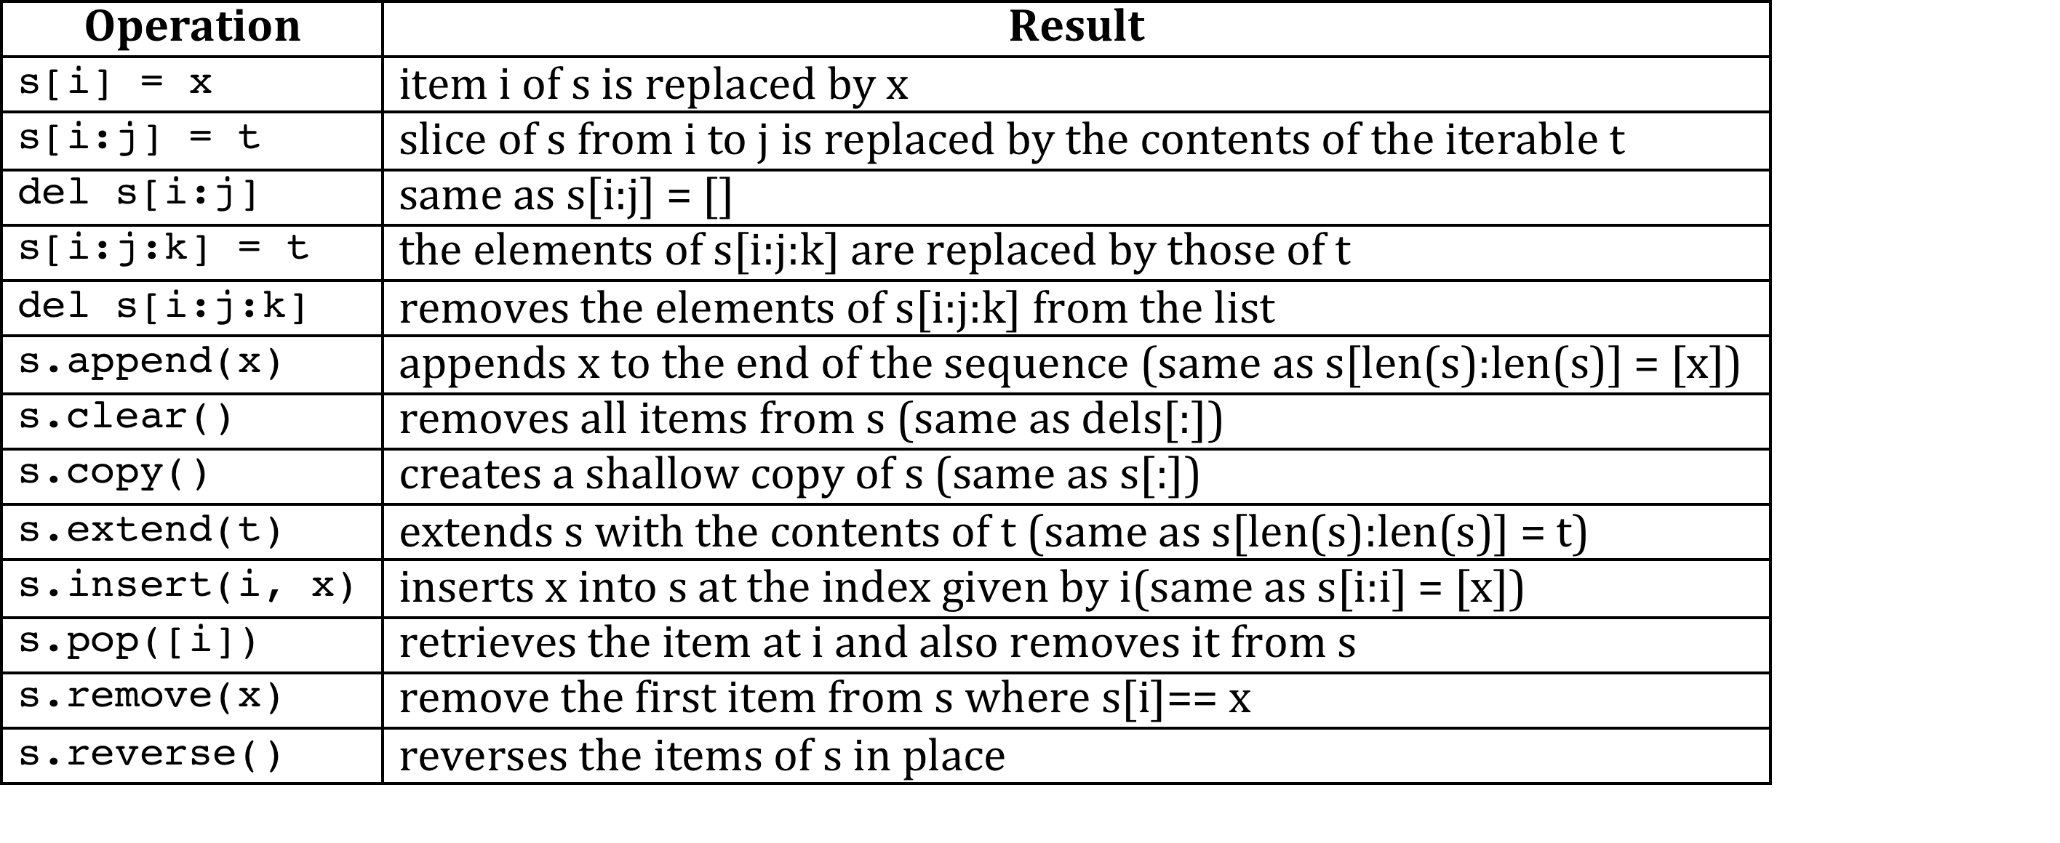
Sequences – Mutable Only

Slide 19
Understanding Assignment
Variables (and parameters) refer (or point) to objects
Assignment (and function parameters) copy references
x
[1,2,3,4,5]
y = x # assignment
x
[1,2,3,4,5]
y

Slide 20
Other Languages
Issue: copying large objects (long arrays)
In Visual Basic, you can pass an argument to a procedure by value or by reference. This is known as the passing mechanism, and it determines whether the procedure can modify the programming element underlying the argument in the calling code. The procedure declaration determines the passing mechanism for each parameter by specifying the ByVal or ByRef keyword.
Quoted from http://msdn.microsoft.com/en-gb/library/ddck1z30.aspx
If an object is immutable, you cannot tell whether it is copied or referenced

Slide 21
Sets and Dictionaries
Set: a collection of unique objects
  Not ordered
  Mutable (but elements must be immutable)
Dictionary: a map from a key to a value
  Unique key
  Mutable (key must be immutable)

Slide 22
Set Examples
Making sets
>>> s = {1,2,3}
>>> t = set(range(2,11,2))
>>> t
{8, 2, 10, 4, 6}
>>> u = s.union([1,1,1])
>>> u
{1, 2, 3}
>>> u = s.intersection(t)
>>> u
{2}
>>> len(s)
3
>>> {2,4}.issubset(t)
True
>>> s.issubset(t)
False
>>>
Set operations

Slide 23
Dictionary Examples
Making a dictionary
>>> d1 = {'milk':2,'eggs':6,'tea':1}
>>> d1
{'eggs': 6, 'tea': 1, 'milk': 2}
>>> len(d1)
3
>>> 'books' in d1.keys()
False
>>> 'records' in d1.keys()
False
>>> d2 = dict([((0,0),'B'),((0,1),'G'),((1,0),'B'),((1,1),'G')])
>>> d2
{(0, 1): 'G', (1, 0): 'B', (0, 0): 'B', (1, 1): 'G'}
>>> d2[(1,1)]
'G'
>>> d1['milk']
2
Check keys
Tuple as a key
Dictionary look up

Slide 24
Dictionaries versus Arrays
Standard Array | Python Dictionary
Index by number | Key can be a string, pair, …
Indices continuous e.g 0 → 10 | Gaps ok
Fixed length | Can add and delete entries
Simple values: number, character | Any value – even a dictionary
In other languages, library has ‘dictionary’ data structure

Slide 25
Exercise
Suggest two representations each for minesweeper and / or hangman
  Write Python to create examples
  Write Python to update the state
    New location in the mine field tested
    New letter guessed in hangman

Slide 26
Exceptions
What Happens When a Problem Occurs

Slide 27
Exception – Example
int("XYZ") – leads to an error
  Not a programming error: user input
  Program stops:
Traceback (most recent call last):
File "<pyshell#32>", line 1, in <module>
int("xyz")
ValueError: invalid literal for int() with base 10: 'xyz'
Error or “exception” name

Slide 28
Exceptions – Trying it out
Try out the code
Certain errors possible
“Catch” the error (i.e. exception) if it occurs and
… run code to “handle” the error.
Words
  “Exception” – a type of error, with a name
  “Handle” – respond to the error nicely
  “Catch” – jump to error-handling statement

Slide 29
Exception – Syntax
Example
try:
in_str = input("Enter a number> ")
in_num = int(in_str)
except ValueError:
print("Sorry", in_str, "is not an integer")
Statements where exceptions may occur
Two new keywords
Only if exception occurs

Slide 30
When to Use Exceptions
Robust code: check for errors
  Why?
Either: Check error cannot occur
Or: Catch exceptions
Exceptions used:
  User input
  OS operation (opening a file)
  When using library code

Slide 31
Summary
Representing data
  Aspect of problem solving
  Easier in Python: build in ‘data structures’
Handle exceptions for robust code

