Slide 1

A Level Computer Science
Topic 8: Software Development & Inheritance
Teaching London Computing
William Marsh
School of Electronic Engineering and Computer Science
Queen Mary University of London

Slide 2
Aims
Review software development lifecycle
Introduce
  Structure modelling
  State modelling
  Object modelling
Introducing inheritance in modelling and Python

Slide 3
Software Lifecycles and Modelling

Slide 4
Are Lifecycles Important?
Comments on mark breakdown table on the AQA practical project
The table does not imply that students are expected to follow a traditional systems life cycle approach when working on their projects, whereby a preceding stage must be completed before the next can be tackled. It is recognised that this approach is unsuited to the vast majority of project work, and that project development is likely to be an iterative process, with earlier parts of the project being revisited as a result of discoveries made in later parts. Students should be encouraged to start prototyping and writing code early on in the project process.

Slide 5
OCR Draft Curriculum
1.2.3 Software Development
Understand the waterfall lifecycle, agile methodologies, extreme programming, the spiral model and rapid application development.
Writing and following algorithms.
The relative merits and drawbacks of different methodologies and when they might be used.

Slide 6
Hacking
Just write a program
Linus Torvald – author of Linux
Good approach for very good programmers
BUT
  Not repeatable (c.f. factory)
  Does not work with teams
Problem: how to organise a large project

Slide 7
Waterfall Life Cycle Model
Key ideas
  S/W development stages
  Sequence: complete in order
  Client knows requirements
  Documents
Critique
  Design problems: separate parts of
  implementation don’t work together
  Requirements problems: client not satisfied at end
  … illusion of progress
Specify
Design
Implement
Test

Slide 8
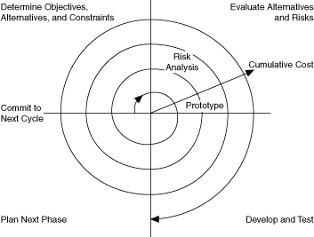
Spiral & Prototypes: Insights
Implementing
helps to
understand a
problem
  Implement
  Refine
Prototypes: users
give feedback on working systems
  Show them a prototype

Slide 9
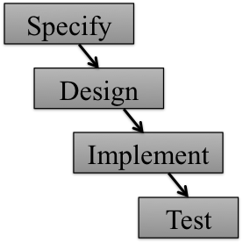
Agile, Extreme, RAD
Lots of books; written by ‘gurus’
Emphasises
  Incremental development (iterations)
  Early working systems
  User feedback
  Automated testing
Increment 1
Increment 2
Increment 3

Slide 10
Summary
Modern lifecycles give less emphasis to a specification
Models
  Still important
  Abstract view of problem or solution
Pseudo code is a model but not very abstract
Flow charts are abstract compared with assembly code but not with a modern high level language

Slide 11
Structure Modelling

Slide 12
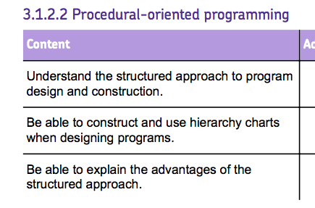
Structured Programming
Early (1970s) and important idea
  Top-down decomposition into functions
  Abstract view of data
  Became OOP
Unstructured
  Use of gotos
  Global data
Global data: hard to see where it is used. Therefore hard to change program

Slide 13
Call Hierarchy
Shows one function calling another
Main program
function 1
function 2
function 3
function 4

Slide 14
Exercises 2.1, 2.2
A simple version of the minesweeper game is available. Download it and review the code. Draw a function-call structure chart.
A very simple version of ‘20 Questions’ randomly selects from a fixed set of animals (for example). The player can see the answers of 3 questions (e.g. how many legs?) chosen from 5. The player then guesses the animal.
Suggest a functional decomposition for this problem.

Slide 15
State Modelling

Slide 16
States
A state is a condition during the life of an object … during which it satisfies some condition, performs some action or waits for some event.
States should
  have a name
  be mutually exclusive
  cover all the possibilities
Possible states of a bank account:
In Credit
Overdrawn
Closed

Slide 17
Events
Events cause a change of the state of an object
Event for a telephone
  ring
  answer
  hang up
  switch off
A change of state is called a transition
Notes:
Something that happens → change of state
Try some everyday example:
glass: empty, full
telephone: on-hook, ringing, ….
bank account
bus – multiple state classifications late/ontime/early/cancelled or moving/stopped or doors opened/doors closed
email message

Slide 18
Events
Events causes a transition between states
Some events are allowed only when an object is in certain states
  e.g. can’t withdraw money from an overdrawn account
withdraw
In Credit
Overdrawn
transition

Slide 19
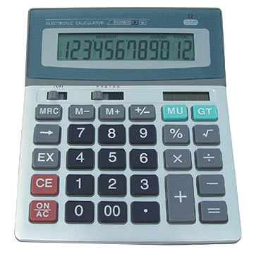
Exercise 3.1
Draw a state-transition model of a simple calculator
  How much detail?

Slide 20
Exercise 3.2
In minesweeper, a square in the minefield
  Can hide a mine or no mine
  The user can
    Flag (claim a mine is present)
    Test (claim no mine is present)
Draw a state model of this. What transitions are needed?
How is the game ended?

Slide 21
Flagged mine
flag
test
Mine
Boom
test
No mine
Clear
Flagged no mine

Slide 22
Object Modelling and Inheritance

Slide 23
Pictures of Classes
Classes
  Thinking about which classes
  Attributes
  Methods
Relationships between classes
  How are classes related?
Person
name
phone number
setNumber
sendText

Slide 24
How Are Classes Related?
An AddressBook contains many Persons
AddressBook
number
addContact
findContact
Person
1 *
name
phone number
setNumber
sendText

Slide 25
Knows-About and Has-A
An AddressBook contains many Persons
The AddressBook contains groups
People are in groups
AddressBook
number
addContact
findContact
Person
name
phone number
setNumber
sendText
1 *
Group
1
*
*
*

Slide 26
Inheritance – Classification
Classify in a hierarchy
Animal
Is a type of
Mammal
Fish

Slide 27
Language of Inheritance
Fish is a sub-class of Animal
Fish is a Animal
Fish inherits from Animal
  Methods are inherited
  Attributes are inherited
Animal is the parent of Fish
Fish is a child of Animal

Slide 28
Inheritance and Overriding
If A has a method M1, then B inherits M1
B can have another method M2, not in A
If A has a method M3, B can define (override) M3 so it behaves differently
A
B

Slide 29
Exercises 4.1
Sketch an Object Model for the minesweeper game
The school has a directory listing students and staff. Different information is held about the different categories of people. Discuss how inheritance can model this.

Slide 30
Inheritance In Python

Slide 31
Inheritance in Python
class Mammal:
def __init__(self, n):
self.name = n
self.legs = 0
def setLegs(self, l):
self.legs = l
def numLegs(self):
return self.legs
def hasFur(self):
return True
def canSwim(self):
return False
Inherits
Superclass constructor
Overrides
class Dog(Mammal):
def __init__(self):
super().__init__("dog")
self.setLegs(4)
def canSwim(self):
return True

Slide 32
Exercises 5.1, 5.2
Enter the classes Mammal and Dog from the slide
  Create a Dog. Find out if the dog has fur, can swim and see
  Add one or more new subclasses, such as: Dolphin, Bat or Cow
Create some classes to draw shapes in turtle graphics (see sheet)

Slide 33
Is Inheritance Useful?
Very in Graphical User Interface libraries
  Much behaviour inherited
  Override when special behaviour needed
In many programs, ‘knows about’ relations are more useful

Slide 34
Summary
Changing attitudes to lifecycles
Different types of modelling
Structure:
  Easy to use but limited
  Encourages structured programming
Object and state modelling
  Both analysis and design

