Slide 1

Programming for GCSE
Topic 9.2: Circuits for Adding
Teaching London Computing
William Marsh
School of Electronic Engineering and Computer Science
Queen Mary University of London

Slide 2
Aims
Show how computers are built from logic gates
Circuit for Adding
  … two inputs
  … three inputs – one column
  … many columns
Key Idea:
Represent numbers as binary digits
Digits as logic levels

Slide 3
Half Adder

Slide 4
Half Adder
Simplest circuit for binary addition
  input: two bits A and B
  output: sum S and carry C
Sums → ? → circuit
A
S
Half-+
B
C
0 + 0 = 0
0 + 1 = 1
1 + 0 = 1
1 + 1 = 0 carry 1
Example:
0
?
Half-+
1
?
Notes:
4

Slide 5
Half Adder – Truth Table
Binary addition – truth table
  input: two bits A and B
  output: sum S and carry C
A B C S
0 0 0 0
0 1 0 1
1 0 0 1
1 1 1 0
Quiz: Determine the formula for S and C
Notes:
5
Bit of time for this (if available)‏

Slide 6
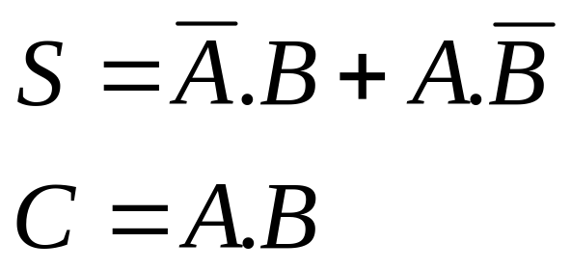
Half Adder – Formula
Simplest circuit for binary addition
  input: two bits A and B
  output: sum S and carry C
A B C S
0 0 0 0
0 1 0 1
1 0 0 1
1 1 1 0
Quiz: draw the circuit
Notes:
6

Slide 7
Half Adder – Circuit
Simplest circuit for binary addition
  input: two bits A and B
  output: sum S and carry C
C
A B C S
0 0 0 0
0 1 0 1
1 0 0 1
1 1 1 0
A
S
B
Notes:
7

Slide 8
Full Adder
One Columns of a Binary Addition

Slide 9
Full Adder – One Column
Each digit (column) of binary add has 3 inputs
  A, B and carry C_{in}
A B C_{in} C_{out} S
0 0 0 0 0
0 0 1 0 1
0 1 0 0 1
0 1 1 1 0
1 0 0 0 1
1 0 1 1 0
1 1 0 1 0
1 1 1 1 1
C_{out}
C_{in}
A
B
C_{in}
S
S
A
Full-+
C_{out}
B
Notes:
9

Slide 10
Full-Adder from 2 Half Adders
Step 1: add A + B
Step 2: add carry to result
Step 3: carry
S’
A
S
Half-+
Half-+
C’
C’’
B
C_{out}
C_{in}
Notes:
10
Explain the OR gate.
Could use algebra. Step 1, equations
S’ = A!B + !AB
C’ = A + B
Cout = (S’ + C’) + Cin
S = (S’+C’)!Cin + !(S’+C’)Cin
Step 2:
Cout = A!B + !AB + Cin
Note that S’+C’ = A + B
S = (A + B)!Cin + !(A + B)Cin
= A!Cin + B!Cin + !A!BCin

Slide 11
Ripple Adder
Add each bit, carry from previous bit
C_{in}
S
A
Full-+
C_{out}
B
Notes:
11

Slide 12
Ripple Adder
Add each bit, carry from previous bit
C_{in} = 0
S₀
A₀
Full-+
B₀
S₁
A₁
Full-+
B₁
S₂
A₂
Full-+
B₂
C_{out}
Notes:
12

Slide 13
Syllabus

Slide 14
Syllabus – Binary
GCSE (OCR)
  Logic circuits: and, or , not
  Truth tables
  Writing boolean expressions
AS/A2 (AQA)
  (AS) More boolean algebra
  (AS) More gates
Joined up view?
How to make sense of logic unless used e.g. adder circuit.
binary → truth table
→ circuit

Slide 15
Summary
Show how logic circuits build a computer
  Binary digits become logic inputs
  Circuits operate on numbers
Adder stages
  One column, no carry
  One column, with carry
  Many columns

