Slide 1

Programming for GCSE
Topic 8.3: Python Turtle Graphics
Teaching London Computing
William Marsh
School of Electronic Engineering and Computer Science
Queen Mary University of London

Slide 2
Aims
Outline the idea of turtle graphics
Evaluate turtle graphics for learning programming

Slide 3
Principles of Turtle Graphics

Slide 4
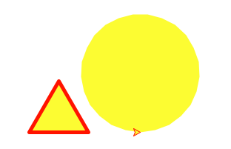
from turtle import *
pencolor('red')
pensize(5)
fillcolor('yellow')
begin_fill()
forward(80), left(120)
forward(80), left(120)
forward(80), left(120)
penup()
forward(150)
circle(80)
end_fill()
done()

Slide 5
from turtle import *
pencolor('red')
pensize(5)
fillcolor('yellow')
begin_fill()
forward(80), left(120)
forward(80), left(120)
forward(80), left(120)
penup()
forward(150)
circle(80)
end_fill()
done()
Pen size and colour
Turtle movement
Fill – start and end
Stop drawing

Slide 6
Documentation
See chapter 23 of Python library
  Functions: simpler, as shown
  Object-orient methods: more flexible
Simplified extract in the practical sheet
  Omits synonyms
  More complex features

Slide 7
How Useful Is Turtle Graphics?
Could use turtle graphics as an introductions

Slide 8
Advantages
Visual
  Picture and simple animation
  Text I/O included
  Not really for graphical UI or games
Problem solving and creativity
Functions
  Obvious need for decomposition into functions

Slide 9
Limitations
Less focus on variables: very important concept
Many problems can be solved (badly) without control structures (if and loops)
Not a great match to GCSE syllabus

Slide 10
Example Challenge Problems
Handle shapes as data
  Save in file
  E.g. ['square', 100, 30, 40] – size, x, y
Do transformations on shapes
  Rotate
  Reflect
Display data
  E.g. bar or line graph

Slide 11
Summary
Turtle graphics is simple and visual
Consider it as an alternative route for transition between visual (e.g. Scratch) and textual programming

