Slide 1

Programming for GCSE
Topic 8.2: Pseudo Code and Flowcharts
Teaching London Computing
William Marsh
School of Electronic Engineering and Computer Science
Queen Mary University of London

Slide 2
Aims
Design: what it about?
Pseudo code
Flowcharts
My views

Slide 3
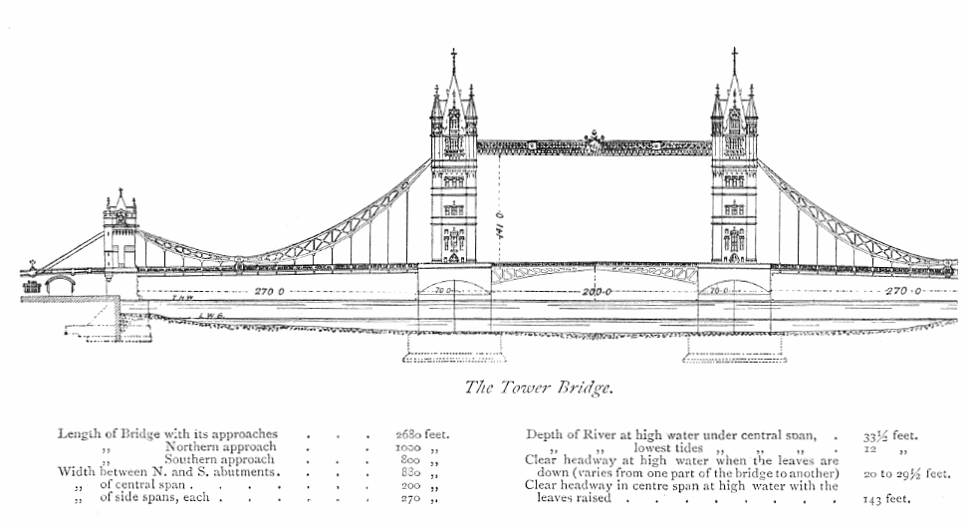
Design
Plan
  Before you build
  How for s/w?
Software is a description!
Steps towards a solution

Slide 4
Pseudo Code

Slide 5
Pseudo Code
Careless or informal code
Useful for
  Making a start
  Breaking a problem done (i.e. design)
  Algorithms without code
AQA has defined a syntax
  Does this miss the point?

Slide 6
Example: Shopping List
initialise shopping list and list of purchase
forever
get command
if command is 'add'
get item and add it to shopping list
if command is 'buy'
get item; transfer from shopping to purchase list
if command is 'print'
print both lists

Slide 7
Flowcharts

Slide 8
Statement Block
Group of instructions
No jumps
Comments!
Arrows implicit
  downwards
  across
description

Slide 9
Decision
Choice of two
If statement
false
true

Slide 10
Example – Largest Value
start
Input two numbers
Output largest
input X, Y
true
X > Y
false
print X
print Y
stop

Slide 11
Quiz – Flowchart for A Loop
Pseudo code
Equivalent flowchart
While condition
statement 1
statement 2
false
?
Condition
true
Statement 1
Statement 2

Slide 12
Syllabus

Slide 13
Specification – Algorithms
Candidates should be able to:
understand algorithms (written in pseudocode or flow diagram), explain what they do, and correct or complete them
produce algorithms in pseudocode or flow diagrams to solve problems.
Also relevant to design in the practical programming activity

Slide 14
Summary
Flowcharts may be useful for understanding programs
Pseudo code like code without the syntax errors

