Slide 1

Programming for GCSE
Topic 7.2: Internet Components
Teaching London Computing
William Marsh
School of Electronic Engineering and Computer Science
Queen Mary University of London

Slide 2
Aims
Explain the main ideas of the Internet
Why is it call the Internet?
How is it run? Is anyone in control?
What's the Internet architecture?
What's a router?

Slide 3
Teaching Issue
As with other network topics
  Principles not just description
  … not overwhelming complexity

Slide 4
The Internet

Slide 5



Hardware of the Internet
get a.mp3

Slide 6
Three Main Components
Hosts: computers running programs
  Client: makes requests to …
  Server: provides a service; waits for requests
    Email, Web, iTunes
Transmission lines
  Copper wire, optical fibre, or radio
Routers: specialized computers that connect multiple transmission lines

Slide 7
Packet Switching
Split a message into chunks
Add a header to each chunk
Send packets independently
Combine received packets
get a.mp3
get a.mp3
h1
get
h1
get
h2
a.mp3
h2
a.mp3
Address of Dest., Packet Id, etc

Slide 8
Routers in Packet Switched Network
Each router is a specialized computer that receives, stores and forwards packets.

Slide 9
Multiplexing
Link can be shared between different data streams
  Division in time – as needed, not fixed

Slide 10
Remarkable!
Internet could have traffic jams
  Shared communication lines
  No central co-ordination
Polite behaviour (particular in TCP) prevents traffic jams (network congestion)
  … but no delivery guarantees

Slide 11
Networks Architecture
Lots of protocols

Slide 12
Protocol
Agreement on how to communicate
Defines:
  format of a message
  actions when data sent & received,
E.g. TCP, IP, UDP, HTTP, SMTP, Ethernet, …

Slide 13
One Protocol for the Internet?
Too many machines in the Internet
Too many problems to solve/implement.
  How to request/receive web pages?
  How to split and combine packets?
  How to find a route to the destination?
  How to send data over physical cables?
  …
Hard to introduce new applications

Slide 14
Layered Architecture
Build a stack of layered protocols, each:
  solves only a few (not all) problems
  defines abstraction of the Internet
Transport
Transport
Network
Network
Data Link
Data Link

Slide 15
Layered Architecture
Build a stack of layered protocols, each:
  solves only a few (not all) problems
  defines abstraction of the Internet
Request web page
Transport
Split into packets
Transport
Network
Find a route
Network
Data Link
Data Link
Send data over cable

Slide 16
End Hosts vs. Routers
host
host
HTTP message
HTTP
HTTP
TCP segment
TCP
TCP
router
router
IP packet
IP packet
IP packet
IP
IP
IP
IP
Ethernet
interface
Ethernet
interface
SONET
interface
SONET
interface
Ethernet
interface
Ethernet
interface

Slide 17
Remarkable!
No one knows how many Internet computers
Decentralised organisation
Many link standards
  Ethernet
  Wifi
  … fibre optic
Internet evolves: new applications

Slide 18
Internet Analogy: Post
Address: town + house – IP address
  Network + host
Mail sorting – router
  Letters find their way: you do not know where the sorting offices are
Various data links
  Post by train, van, bike
Shared infrastructure
  You post a letter when you want – capacity?

Slide 19
IP Addresses

Slide 20
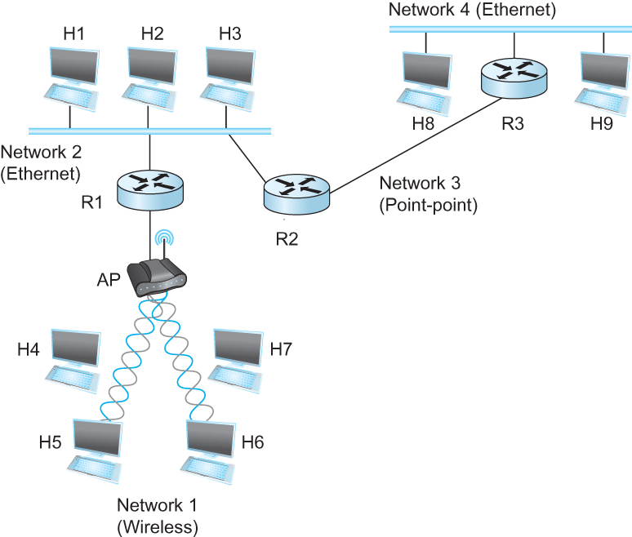
Internetworking
Internetwork
  Interconnected networks
  → network address
  Host-host to packet delivery
  → host address

Slide 21
IP Address
For computers (hosts) on the Internet
  Globally unique
Consists of 4 bytes. Written as “aa.bb.cc.dd”
  Hierarchical: network + host
  Router: multiple addresses
E.g. (Real)
  www.amazon.co.uk : 87.238.85.129
  www.facebook.com : 204.15.20.80
  www.eecs.qmul.ac.uk : 138.37.95.150
  frank.eecs.qmul.ac.uk : 138.37.88.242

Slide 22
How Are Addresses Allocated?
IANA The Internet Assigned Numbers Authority
ICANN Internet Corporation for Assigned Names and Numbers
IANA
  manages the IP address space allocations globally
  delegates five regional Internet registries (RIRs)
IANA is managed by ICANN
  under contract to the US Department of Commerce
Regional Internet Registries
  allocate IP address blocks to local ISPs

Slide 23
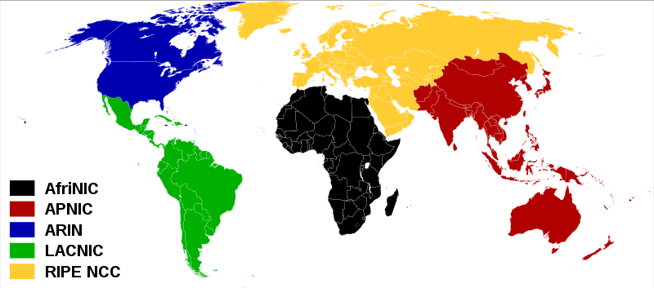
Regional Internet Registries
Réseaux IP Européens Network Coordination Centre (RIPE) for Europe, the Middle East, and Central Asia

Slide 24
Who Got the Addresses?
Class A (16 million hosts) see: http://en.wikipedia.org/wiki/List_of_assigned_/8_IPv4_address_blocks
25.0.0.0/8 UK Ministry of Defence (RSRE)
51.0.0.0/8 UK Government Department for Work and Pensions
AS3161 Queen Mary and Westfield College (SuperJANET SMDS)
161.23.0.0/16 Queen Mary and Westfield College
138.37.0.0/16 Queen Mary and Westfield College
192.135.234.0/24 Queen Mary and Westfield College
192.135.231.0/24 Queen Mary and Westfield College

Slide 25
Configuration
DNS – an example

Slide 26
Remarkable!
No centralised configuration
Automatic configuration
  Granny takes laptop to coffee shop
  … IP address allocated
  … connected to Internet
  … can send mail

Slide 27
Domain Name System (DNS)
Translate URL → IP
  Yellow pages of the Internet
Decentralized management
Hierarchy of DNS servers
  Root servers
  Top-level domain (TLD) servers
  Authoritative DNS servers

Slide 28
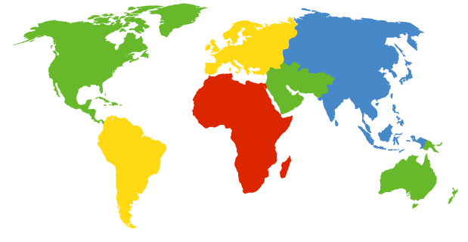
DNS Root Servers
13+ root servers (see http://www.root-servers.org/)
Labeled A through M
A Verisign, Dulles, VA
C Cogent, Herndon, VA (also Los Angeles)
D U Maryland College Park, MD
G US DoD Vienna, VA
H ARL Aberdeen, MD
J Verisign, ( 11 locations)
K RIPE London (also Amsterdam, Frankfurt)
I Autonomica, Stockholm (plus 3 other locations)
E NASA Mt View, CA
F Internet Software C. Palo Alto, CA (and 17 other locations)
m WIDE Tokyo
B USC-ISI Marina del Rey, CA
L ICANN Los Angeles, CA

Slide 29

Top Level Domain (TLD) Servers
Top-level domain (TLD) servers
  Generic domains (e.g., com, org, edu)
  Country domains (e.g., uk, fr, ca, jp)
  Typically managed professionally
Nominet www.nic.uk
the Internet registry
for .uk domain names

Slide 30
Authoritative DNS Servers
Authoritative DNS servers
  Provide public records for hosts at an organization
  For the organization’s servers (e.g., Web and mail)
  Can be maintained locally or by a service provider
START-UP register a new .com?
  Add to the .com TLD
Add a new domain to myco.com
  Add to the myco authoritative sever

Slide 31
Summary

Slide 32
Summary
Internet – connected networks
  Independently run
Agreed protocols
  'IP' for an Internet address
Decentralised control

