Slide 1

Programming for GCSE
Topic 6.2: Testing
Teaching London Computing
William Marsh
School of Electronic Engineering and Computer Science
Queen Mary University of London

Slide 2
Aims
Understand the idea of testing
Understand ideas behind the GCSE requirements
  E.g. OCR Unit 3 Programming Task

Slide 3
Principles of Testing

Slide 4
Test Case
A use of a program
  Particular input → Test Data
Expected results
Actual result
Important programs are tested using lots of test cases

Slide 5
Test Data
The values used to test a program
  FROM PROBLEM (not program)
Valid
  Expected to be accepted by the program
Extreme
  Check ‘boundaries’
Invalid
  Expected to be rejected

Slide 6
Boundary Values
if x > 10 and x <= 17 :
print("Ans is", x + y)
else :
print("Out of range")
Boundaries are:
  x == 10 – out of range: just too small
  x == 11 – in range: just large enough
  x == 17 – in range: just small enough
  x == 18 – out of range: just too big

Slide 7
Test Plan / Evidence
Shows tests and results
Test | Data | Reason | Expected | Outcome
1 | x = 11, y = 10 | x in range, y positive | Ans is: 21 | Correct
2 | x = 11, y = - 5 | x in range, y negative | Ans is: 6 | Correct
3 | x = 17, y = 20 | x in range, y positive | Ans is: 37 | Correct
4 | x = 17, y = -20 | x in range, y negative | Ans is: -3 | Correct
5 | x = 10, y = -1 | x out of range | Out of range | Correct
6 | x = 18, y = 100 | x out of range | Out of range | Correct

Slide 8
GCSE Syllabus – OCR Specification
Use a suitable test plan and data to test functions of the system
AS/A2
  Similar, but more complex application

Slide 9
Teaching Issue
Are industry processes relevant?
  Systems very complex
  Lots of tests
… can be tedious for small scale projects
When to write test plan?
Link to
  Bugs in s/w we use; bugs in open source projects
  Social / ethical

Slide 10
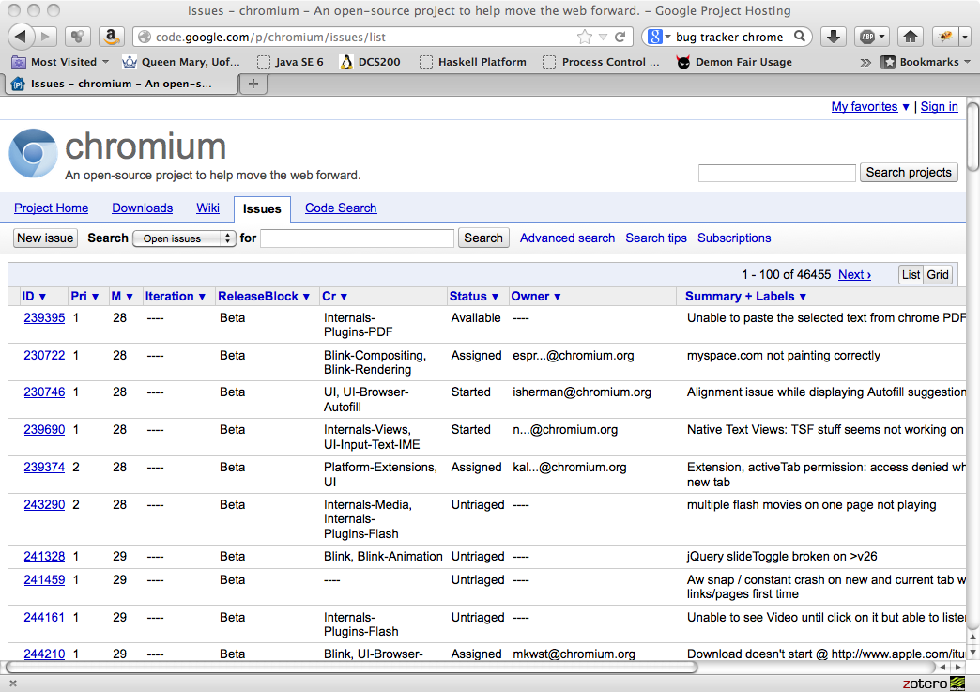
Bug List - Example

Slide 11
Example

Slide 12
OCR Unit 3 Task A Example
Design, code and test a program to calculate the body mass index (BMI) for an adult.
The program should work in metric units (kg and cm) or imperial units (stones and pounds, and feet and inches). The user should be able to choose which units. The system should output the BMI and the appropriate category from:
  Less than 18.5 – Underweight
  Between 18.5 and 25 – Normal
  Between 25 and 30 – Overweight
  Greater than 30 – Obese
The formulae are:
Metric: BMI = weight in Kg / (height in cm) ²
Imperial: BMI = (weight in pounds x 703) / (height in inches)²
Incorrect! m not cm

Slide 13
Analysis
Height ranges
  4 ft – 7 ft
  122 cm to 213 cm
Weight
  4st, 0lb to 30st, 0lb
  25kg to 190 Kg

Slide 14
Test Data (Spreadsheet)
Stone | Pounds | Feet | Inches | Pounds | Inches | BMI | UnderW? | Obese | Normal | OverW | CM | Kg
5 | 7 | 6 | 0 | 77 | 72 | 10.4 | Yes | No | No | No | 182.9 | 34.9
6 | 7 | 6 | 1 | 91 | 73 | 12.0 | Yes | No | No | No | 185.4 | 41.3
7 | 7 | 6 | 2 | 105 | 74 | 13.5 | Yes | No | No | No | 188.0 | 47.6
8 | 7 | 5 | 7.5 | 119 | 67.5 | 18.4 | Yes | No | No | No | 171.5 | 54.0
9 | 7 | 5 | 7 | 133 | 67 | 20.8 | No | No | Yes | No | 170.2 | 60.3
10 | 7 | 5 | 6 | 147 | 66 | 23.7 | No | No | Yes | No | 167.6 | 66.7
11 | 7 | 5 | 5 | 161 | 65 | 26.8 | No | No | No | Yes | 165.1 | 73.0
12 | 7 | 5 | 4 | 175 | 64 | 30.0 | No | Yes | No | No | 162.6 | 79.4
13 | 7 | 5 | 3 | 189 | 63 | 33.5 | No | Yes | No | No | 160.0 | 85.7
14 | 7 | 5 | 2 | 203 | 62 | 37.1 | No | Yes | No | No | 157.5 | 92.1
15 | 7 | 5 | 1 | 217 | 61 | 41.0 | No | Yes | No | No | 154.9 | 98.4
16 | 7 | 6 | 2 | 231 | 74 | 29.7 | No | No | No | Yes | 188.0 | 104.8
8 | 2.6 | 5 | 6.1 | 114.6 | 66.1 | 18.4 | Yes | No | No | No | 168.0 | 52.0
8 | 4.8 | 5 | 6.5 | 116.8 | 66.5 | 18.6 | No | No | Yes | No | 169.0 | 53.0
8 | 11.5 | 5 | 3.0 | 123.5 | 63.0 | 21.9 | No | No | Yes | No | 160.0 | 56.0
9 | 1.9 | 5 | 2.2 | 127.9 | 62.2 | 23.2 | No | No | Yes | No | 158.0 | 58.0
9 | 6.3 | 5 | 1.4 | 132.3 | 61.4 | 24.7 | No | No | Yes | No | 156.0 | 60.0
9 | 10.7 | 5 | 0.6 | 136.7 | 60.6 | 26.1 | No | No | No | Yes | 154.0 | 62.0
10 | 1.1 | 4 | 11.8 | 141.1 | 59.8 | 27.7 | No | No | No | Yes | 152.0 | 64.0
10 | 7.7 | 4 | 11.1 | 147.7 | 59.1 | 29.8 | No | No | No | Yes | 150.0 | 67.0
10 | 5.5 | 4 | 10.3 | 145.5 | 58.3 | 30.1 | No | Yes | No | No | 148.0 | 66.0

Slide 15
Test Plan (Incomplete)
Test | Data | Reason | Expected | Result
1 | 5ft,7in 8st,6lb | Imperial In range | BMI 18.5 Underweight
2 | 5ft, 4in 11st, 7lb | Imperial In range | BMI 30.0 Obese
3 | 160cm, 56 Kg | Metric In range | BMI 21.9 Normal
4 | 300 cm, 56 Kg | Height too large | N/A

Slide 16
Summary
Technique and process
Expected to be used

