Slide 1

Programming for GCSE
Topic 4.2: Faults and Debugging
Teaching London Computing
William Marsh
School of Electronic Engineering and Computer Science
Queen Mary University of London

Slide 2
Aims
What goes wrong and when?
  Understanding the faults at different stages of program execution
Techniques for debugging
  Form a hypothesis
  Halve the problem
Debugger
  Principles
  Demo

Slide 3
Teaching Issue
Simple errors can be disproportionately difficult at first
  Does it help to understand more?
Teach some tactics for fixing errors
  The limits of ‘just changing something’
When to introduce the debugger
  Is it useful?

Slide 4
Understanding What Goes Wrong
… and when

Slide 5
Types of Errors
Program text
Syntax errors
  Brackets
  String
  Indentation
Execution errors
  Names
  Expressions
  Variables
Parsing
Parsed program
Execution
Output

Slide 6
Types of Errors
Syntax
  The words make no sense
  The words do not make a sentence
Execution errors
  I cannot understand that sentence
  I know what you mean, but I cannot do that
Python has more execution errors
  Other languages have a type checker

Slide 7
Bugs
The program works, but it isn’t the program you wanted!
number=int(input("Enter a Binary Number> "), 3)
print("In Base 10, the number is: ", str(number))
print("In Octal, the number is: ", hex(number))
print("In Hexadecimal, the number is: ", oct(number))
Enter a Binary Number> 1011
In Base 10, the number is: 31
In Octal, the number is: 0x1f
In Hexadecimal, the number is: 0o37

Slide 8
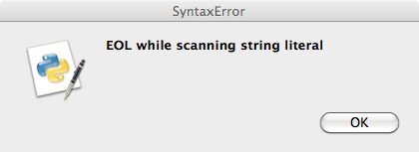
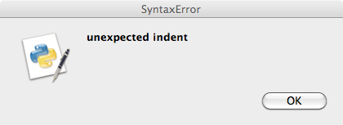
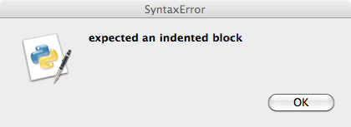
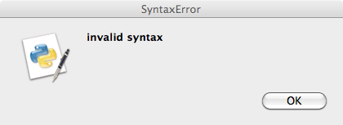
Syntax Errors
Strings: must close
Indentation
  Proper boxes
Brackets
  Must match

Slide 9
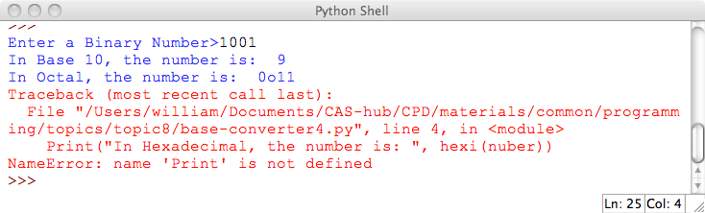
Execution Errors – Names
Names: As variables are not declared, any name could be a variable
number=int(input("Enter a Binary Number>" ), 2)
print("In Base 10, the number is: ", str(number))
print("In Octal, the number is: ", oct(number))
Print("In Hexadecimal, the number is: ", hexi(nuber))

Slide 10
Execution Errors
Names
  As variables are not declared, any name could be a variable
Variable
  Must be assigned before used
Expression
  The operator does not exist
  E.g. “David” – “Cameron”
  The operator has no answer for the values
  E.g. “David”[5]

Slide 11
Demonstrations

Slide 12
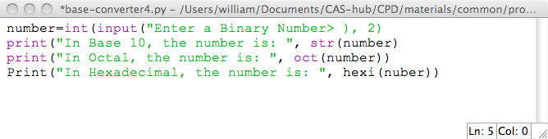
Demo 1

Slide 13
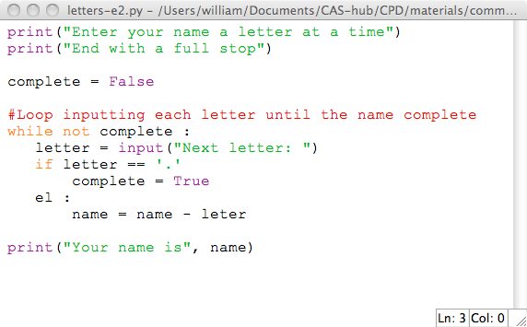
Demo 2

Slide 14
Tactics for Finding Errors
Test often

Slide 15
Where is the Error?
Hard to find if you are looking in the wrong place
  Syntax errors may ‘appear’ after real location
Use comments to shrink program
Look at the line number in the message
Print something before error

Slide 16
Importance of ‘Hypothesis’
“I think the problem is …”
Have an idea .. test it … revise it
Alternative is to make ‘random’ changes

Slide 17
Debugger
Watch the program working

Slide 18
Debugger - Principles
Breakpoint
  Stop the program in progress
Observe the values of variable

Slide 19
Demo of Debugger
See separate demo.

Slide 20
Summary
Finding errors is difficult
  Lots of errors at first
Does it help to understand the types of errors
Teach good habits
  Be systematic in finding errors
  Have a ‘hypothesis’
Bad habits: make changes without thought

