Slide 1

Programming for GCSE
Topic 3.3: Boolean Logic and Truth Tables
Teaching London Computing
William Marsh
School of Electronic Engineering and Computer Science
Queen Mary University of London

Slide 2
Aims
Introduce the study of logic
  Introduction to logic
  Truth tables
  Logic and programming
  Writing logic – Boolean algebra
  …
'Logic gates' are covered later

Slide 3
Teaching Issue
How to provide a coherent, joined up view
  Some curricula include logic circuits but it is not related to operation of a computer
Abstraction e.g. 'X and Y'
  Best way in?
Notation?
  Unfortunately, several used

Slide 4
Introduction to Logic
True and False

Slide 5
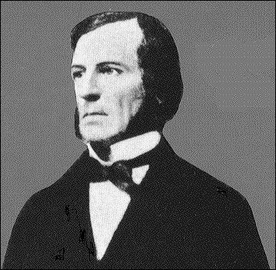
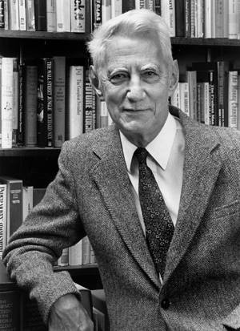
Some History
George Boole
  Invented ‘Boolean Algebra’
  Makes 'logic' into mathematics
  "An Investigation of the Laws of Thought", 1854
Claude Shannon
  A Symbolic Analysis of Relay and Switching Circuits, 1938
  Based on his master’s thesis.
Notes:
In 1932 he entered the University of Michigan, where he took a course that introduced him to the works of George Boole. He graduated in 1936 with two bachelor's degrees, one in electrical engineering and one in mathematics, then began graduate study at the Massachusetts Institute of Technology, where he worked on Vannevar Bush's differential analyzer, an analog computer.
While studying the complicated ad hoc circuits of the differential analyzer, Shannon saw that Boole's concepts could be used to great utility. A paper drawn from his 1937 master's thesis, A Symbolic Analysis of Relay and Switching Circuits, was published in the 1938 issue of the Transactions of the American Institute of Electrical Engineers. It also earned Shannon the Alfred Noble American Institute of American Engineers Award in 1940. Howard Gardner, of Harvard University, called Shannon's thesis "possibly the most important, and also the most famous, master's thesis of the century".
In this work, Shannon proved that Boolean algebra and binary arithmetic could be used to simplify the arrangement of the electromechanical relays then used in telephone routing switches, then turned the concept upside down and also proved that it should be possible to use arrangements of relays to solve Boolean algebra problems. Exploiting this property of electrical switches to do logic is the basic concept that underlies all electronic digital computers. Shannon's work became the foundation of practical digital circuit design when it became widely known among the electrical engineering community during and after World War II. The theoretical rigor of Shannon's work completely replaced the ad hoc methods that had previously prevailed.

Slide 6
True or False?
Logic view: true or false
  'My name is David'
  'Today is a Tuesday'
Proposition: a statement that is true or false
In reality, some statements are more complex
  'That colour suits you'
  'You are the most beautiful girl in the world'

Slide 7
Writing Logic
Boolean Algebra

Slide 8
Logical / Boolean Variables
X, Y - (an uppercase letter)
A variable that may be true of false
A proposition

Slide 9
Writing Logic
Python Logic Gates Maths
X . Y
X + Y
X
1
0
X and Y
X or Y
not X
True
False
‘X’, ‘Y’ are Boolean variables
x ∧ y
x ∨ y
¬x
true
false

Slide 10
Truth Tables:
AND, OR, NOT

Slide 11
Truth Tables
Table of all variables in a Boolean formula
2 variables
Each row has a possible combination of X and Y
Table covers all possibilities
X | Y | Result
0 | 0
0 | 1
1 | 0
1 | 1

Slide 12
AND, OR
True when either X or Y true
OR
AND
X Y X or Y
0 0 0
0 1 1
1 0 1
1 1 1
True when both X and Y true
X Y X and Y
0 0 0
0 1 0
1 0 0
1 1 1

Slide 13
NOT
X not X
0 1
1 0

Slide 14
Logic and Boolean Expressions
… Python programming

Slide 15
Boolean Expressions
Combine conditions
If A, B are conditions – true or false
Expression | Description
A and B | Both A true and B true
A or B | Either A true or B true
not A | True when A is false

Slide 16
Examples
What are the values of the following?
Expression | True or False?
10 > 5 or "hello"[1] == "e"
2 + 3 < 10 and 6 != 6
10 != 11 or 5 != 5
10 < 10 and "world"[1:3] == "or"
not (10 >= 11)

Slide 17
Compare these programs:
if age >= 21 and age <= 25:
print("Great age")
else:
print("Not so good! ")
if age >= 21:
if age <= 25:
print("Great age")
else:
print("Not so good!")
else:
print("Not so good!")
Equivalent
Nested 'if' statement

Slide 18
Using Truth Tables to Check Equivalence

Slide 19
Truth Tables
Table of all variables in a boolean formula
2 variables
  4 row
3 variables
  8 rows
4 variables
  16 rows
Two formula same
if (and only if)
same truth table
X | Y | Z | Result
0 | 0 | 0
0 | 0 | 1
0 | 1 | 0
0 | 1 | 1
1 | 0 | 0
1 | 0 | 1
1 | 1 | 0
1 | 1 | 1

Slide 20
Comparing Formulae using Truth Table
Use a truth table to check equivalence
Are the two formula the same:
not (A and B)
(not A) or (not B)
( A . B ) = A + B
A B NOT(A . B) (NOT A) + (NOT B)
0 0
0 1
1 0
1 1

Slide 21
Comparing Formulae using Truth Table
Use a truth table to check equivalence
( A . B ) = A + B
A B NOT(A . B) (NOT A) + (NOT B)
0 0 0 1 1
0 1 0 1 0
1 0 0 0 1
1 1 1 0 0

Slide 22
Comparing Formulae using Truth Table
Use a truth table to check equivalence
( A . B ) = A + B
A B NOT(A . B) (NOT A) + (NOT B)
0 0 1 0 1 1 1
0 1 1 0 1 1 0
1 0 1 0 0 1 1
1 1 0 1 0 0 0

Slide 23
QUIZ: Are these the same?
if age >= 20 and age <= 25:
print("Great age")
else:
print("Not so good! ")
if age < 20 or age > 25:
print("Not so good!")
else:
print("Great age")

Slide 24
Comparing Formulae using Truth Table
QUIZ: use a truth table to check
( A + B ) = A . B
A B NOT(A + B) (NOT A) . (NOT B)
0 0
0 1
1 0
1 1

Slide 25
Rules of Boolean Algebra

Slide 26
Boolean Algebra Rules
Rules for NOT
Associative rules
A . A = 0 never A and not A
A+A = 1 always A or not A
A.(B.C) = (A.B).C and associative
A+(B+C) = (A+B)+C or associative
Notes:
Draw the associative laws as circuits

Slide 27
De-Morgan’s Laws
Important law for exchanging AND with OR
‘A and B’ is false when either A is false or B is false
( A . B ) = A + B
‘A or B’ is false when both A is false and B is false
( A + B ) = A . B

Slide 28
Summary
Logical expressions
  AND, OR, NOT
Logic and programming
  Reasoning about conditions
Truth table
  Equivalence of expressions
Boolean expression (formula)
  Algebraic rules
Next stop: logic circuits

